Slide 1
Reading Updates at Inspire

Slide 2
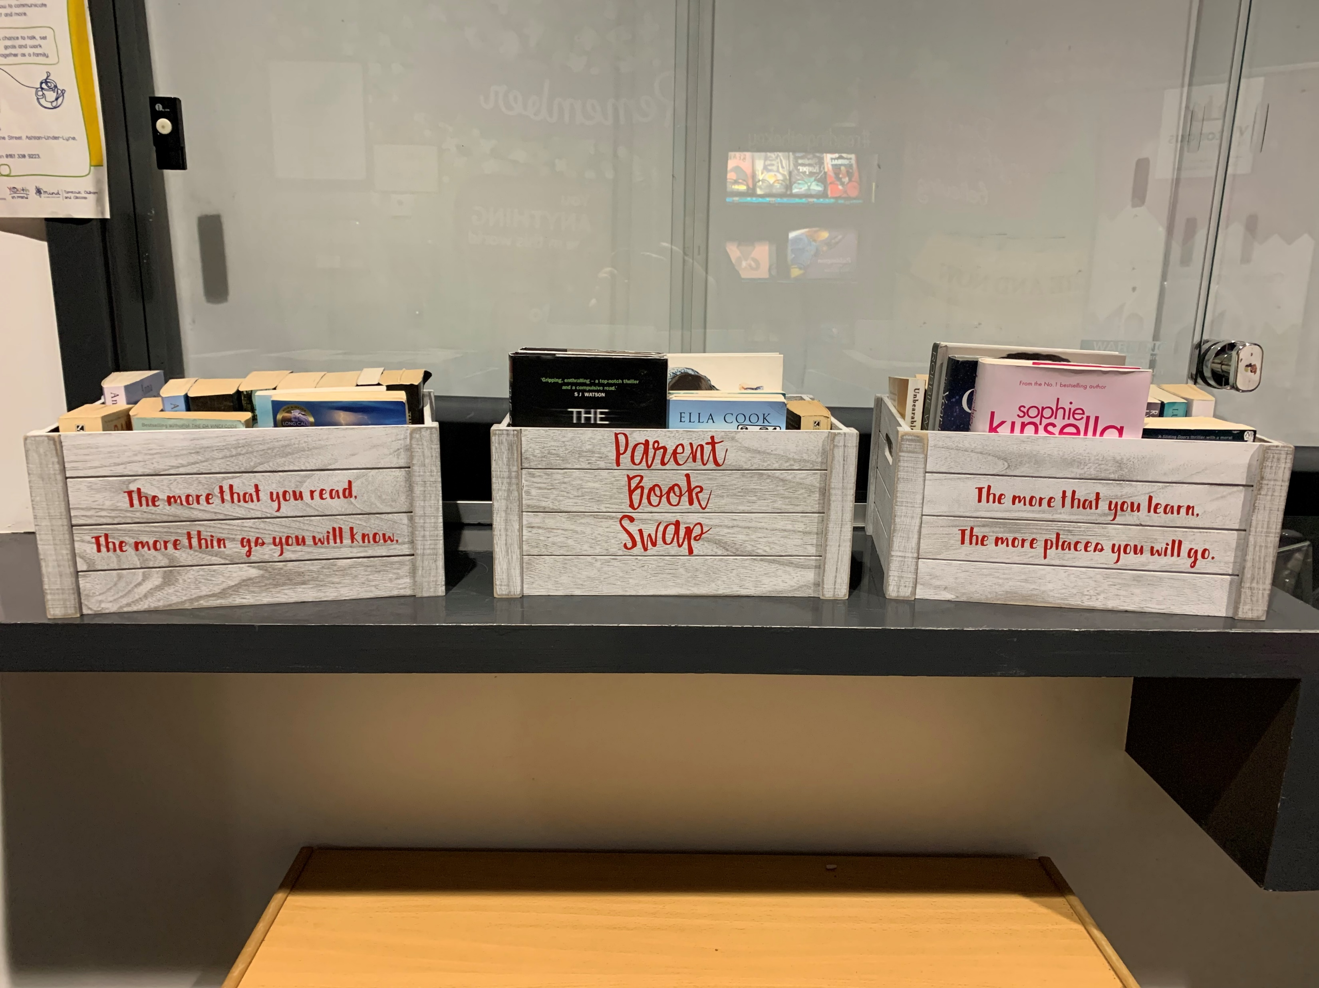
Our new parent book swap set up!

Slide 3
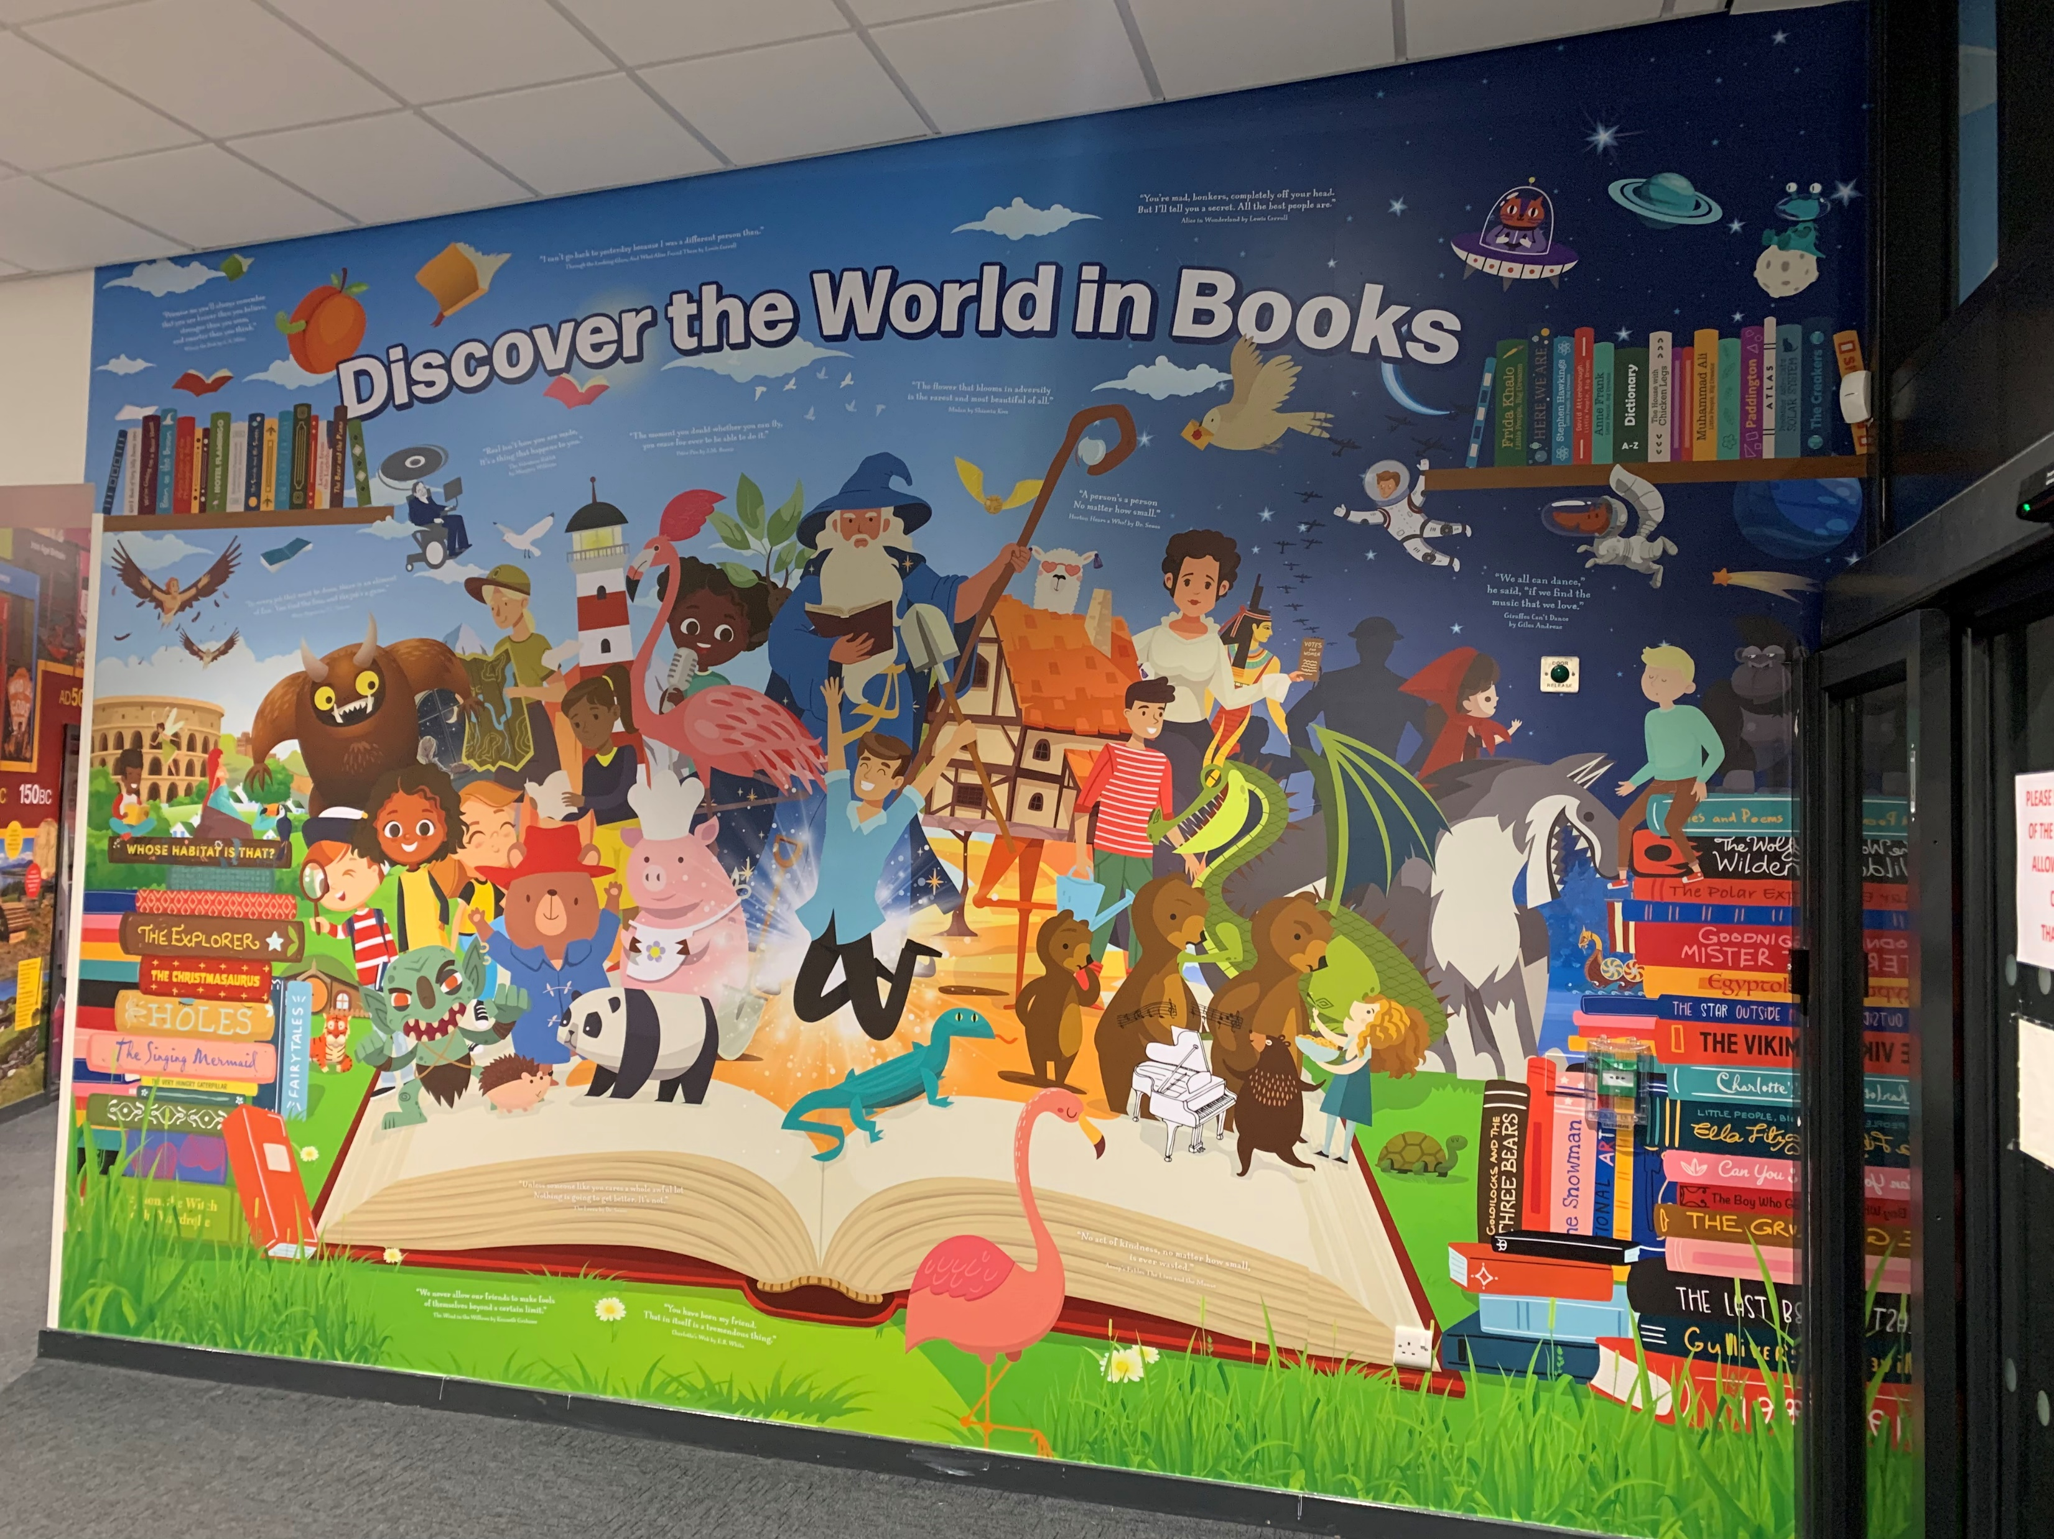
Our amazing new reading wall!

Slide 4
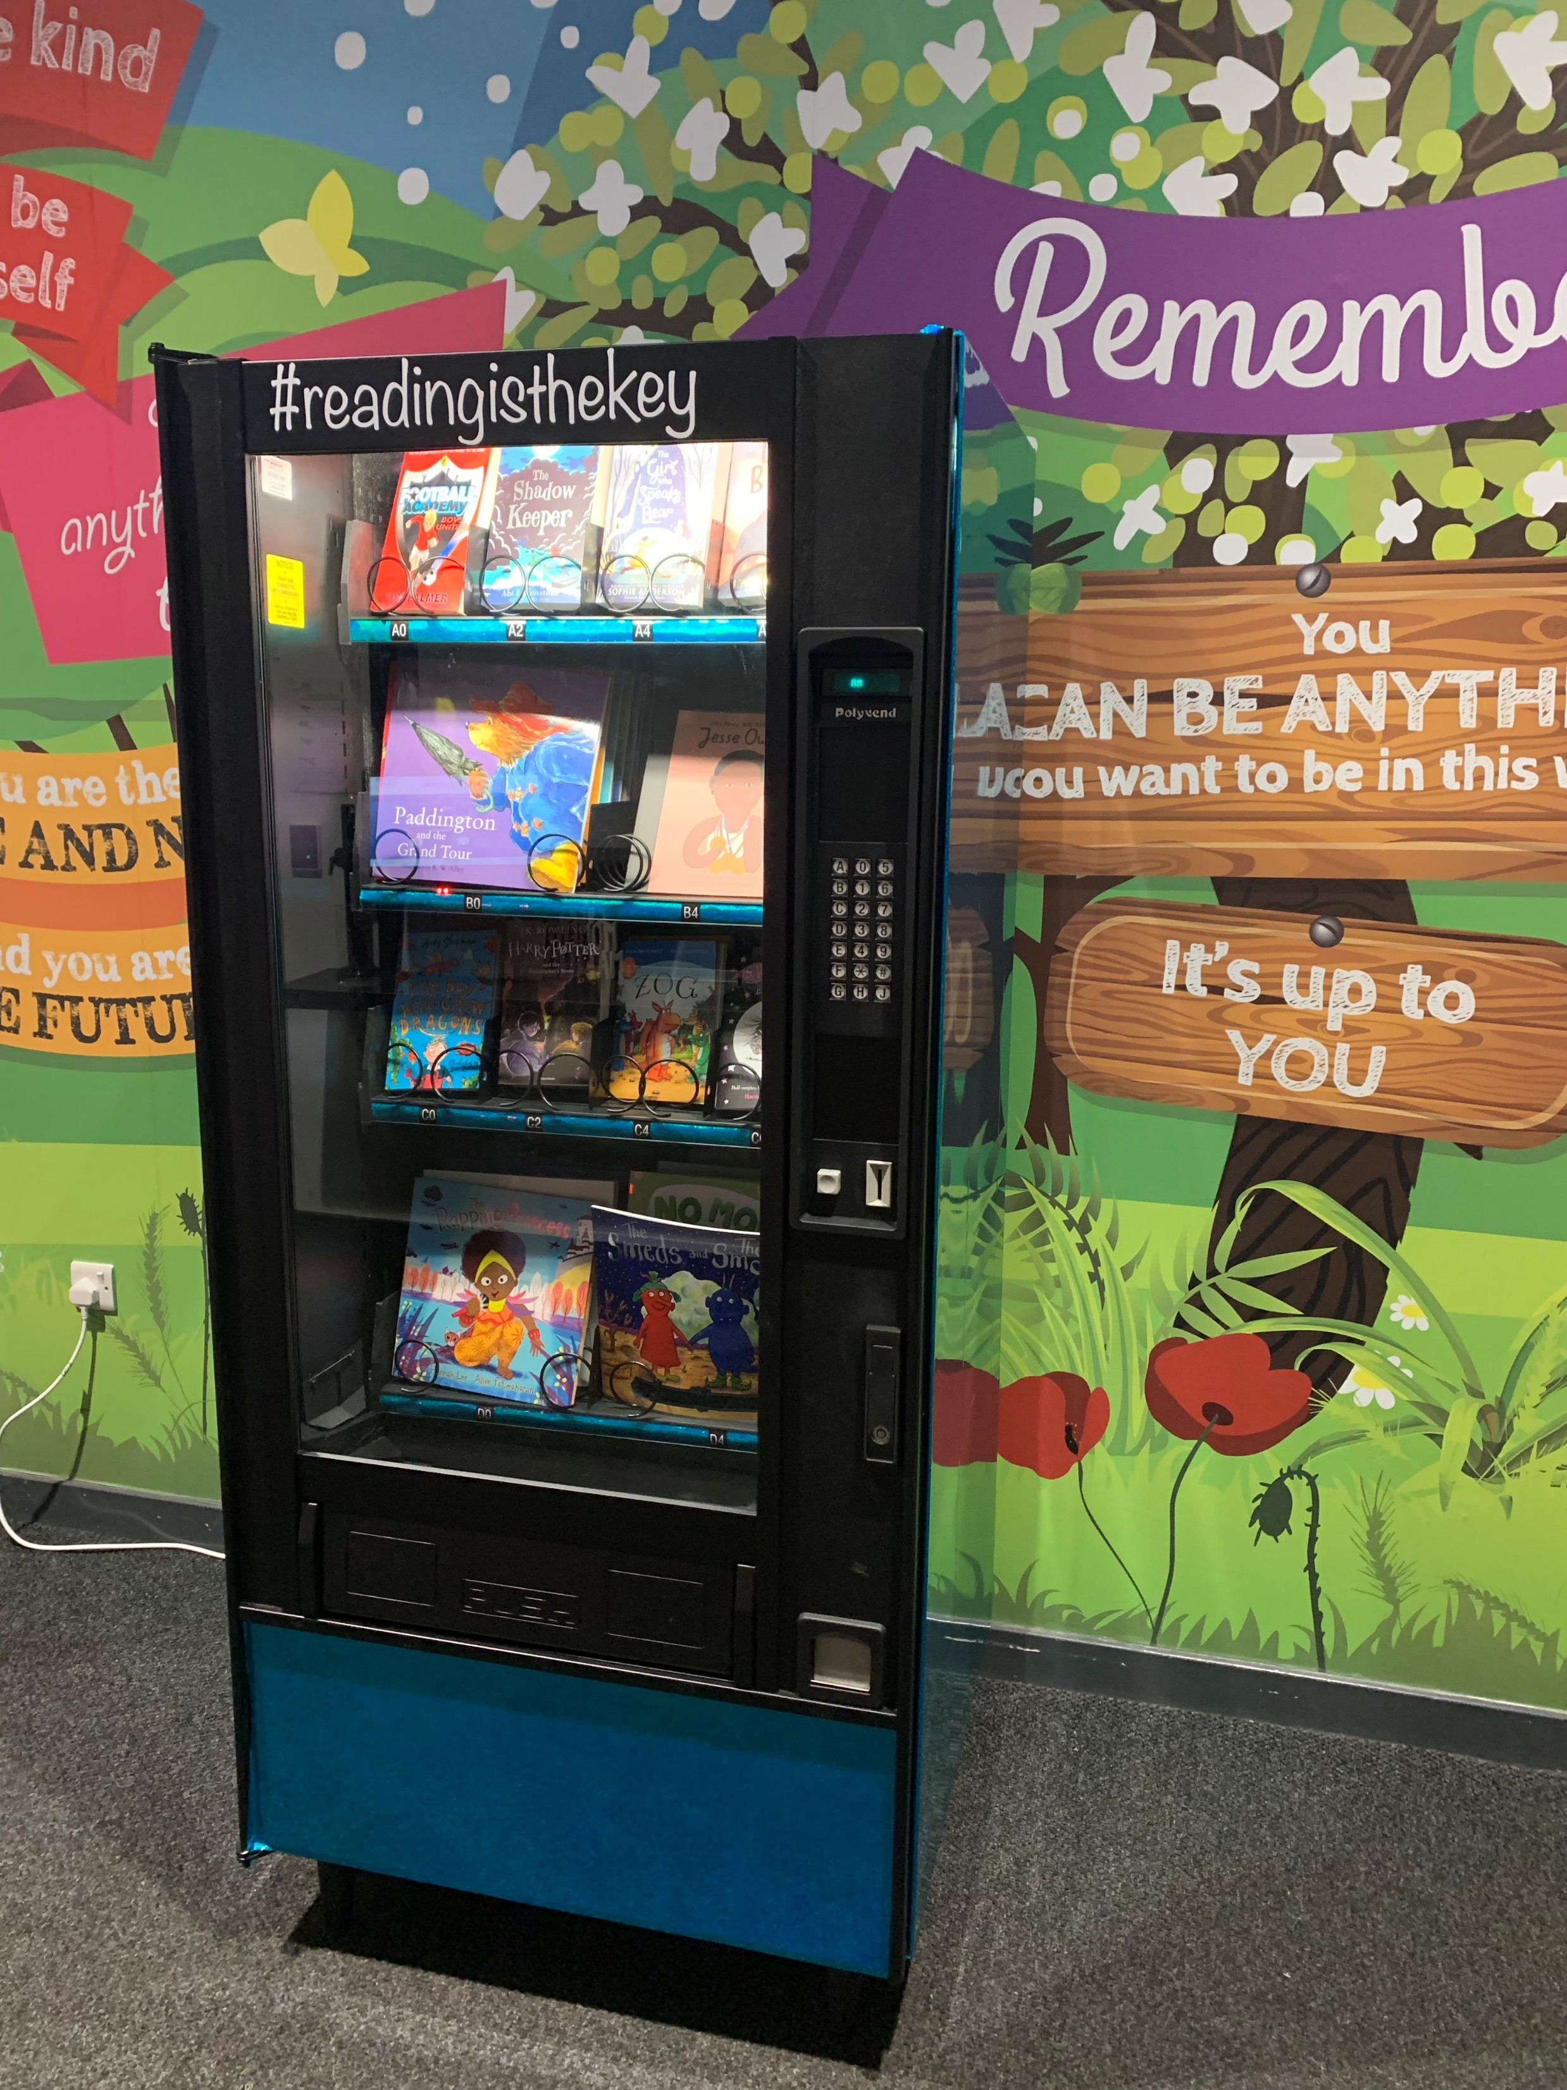
We now have a vending machine filled with books, ready for our termly winners of the reading for pleasure awards!

Slide 5
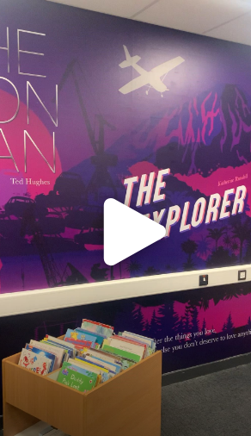
We are so impressed with our new library! It provides us with such an immersive experience when we spend time in there each week. Click the link below to take a peek:
Library video.MOV

Slide 6

We are a One Education GOLD award accredited school…

Slide 7

The Summer Reading Challenge 2025
We have won The Summer Reading Challenge for the 7th year running!
We are so proud of the children for continuing that love of reading outside of school.

