Slide 1
Reading Updates at Inspire

Slide 2
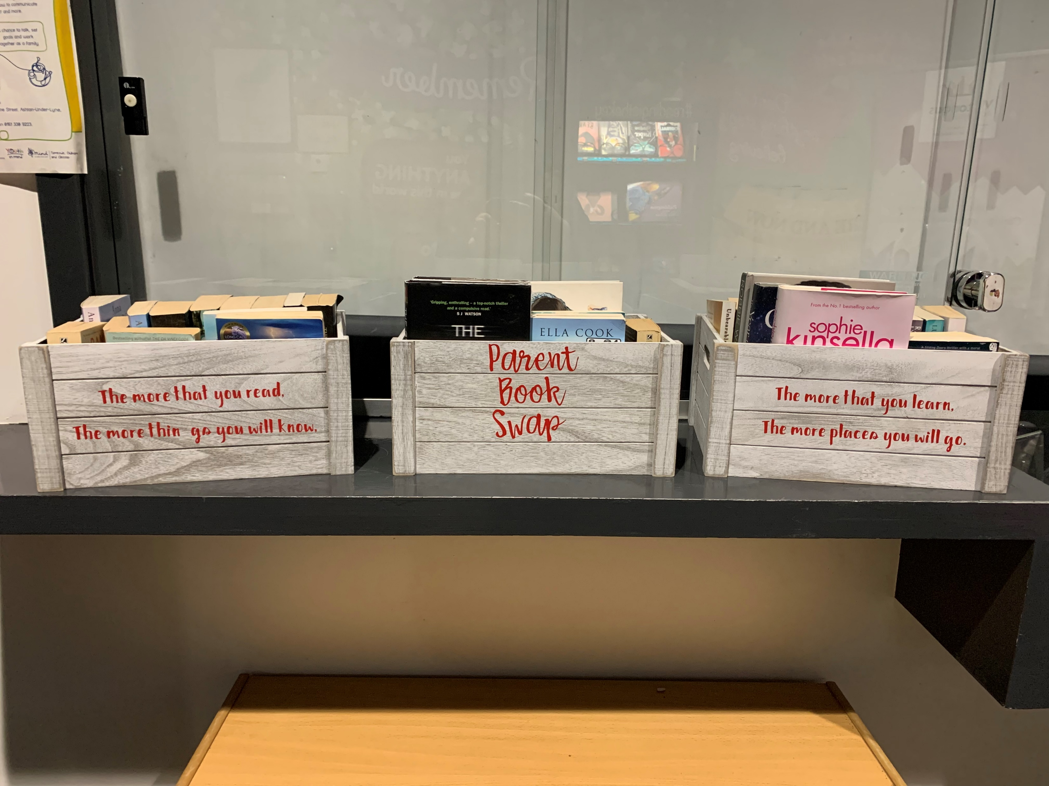
Our new parent book swap set up!

Slide 3
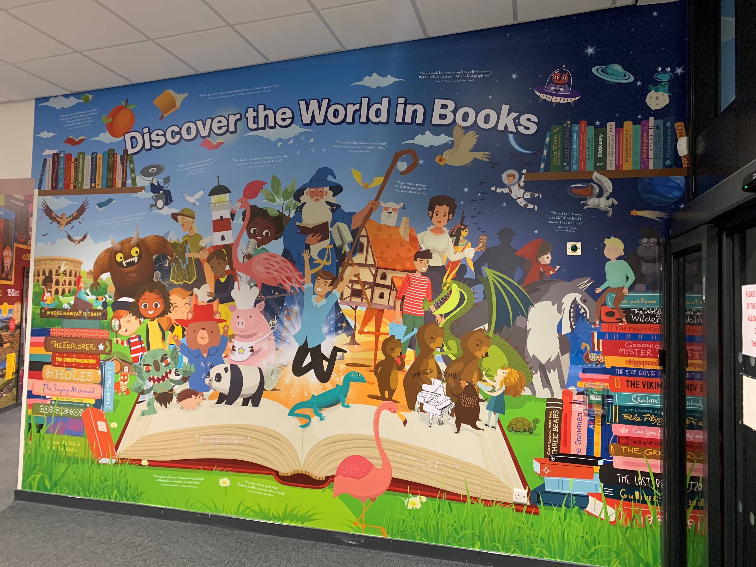
Our amazing new reading wall!

Slide 4
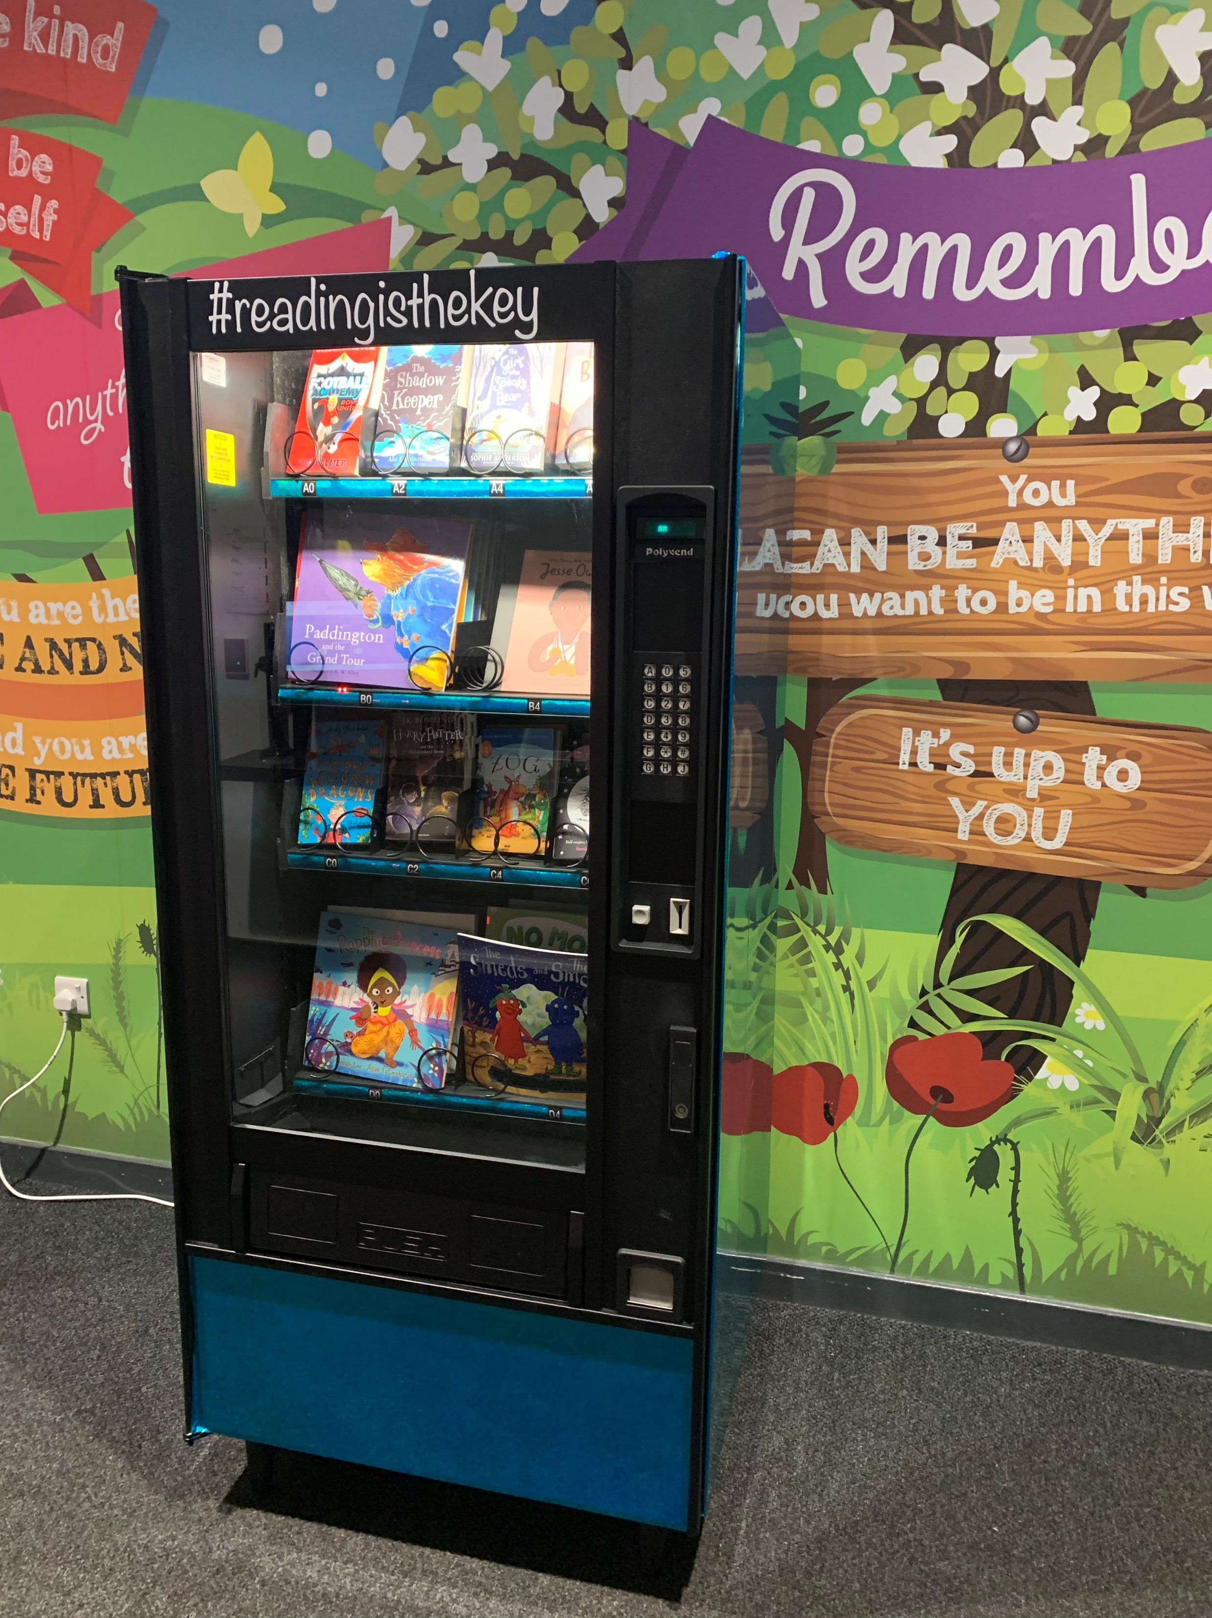
We now have a vending machine filled with books, ready for our termly winners of the reading for pleasure awards!

Slide 5
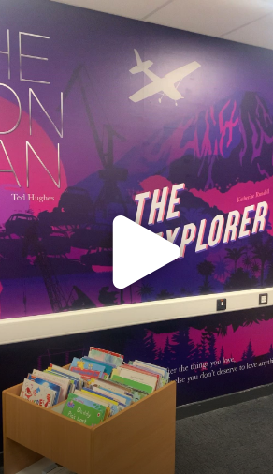
We are so impressed with our new library! It provides us with such an immersive experience when we spend time in there each week. Click the link below to take a peek:
Library video.MOV

