Slide 1
World Book Day
2022

Slide 2
The Masked Reader Teachers used an app to disguise themselves in order to read us a story. We then had to guess which Teacher was reading!

Slide 6
Author Visit We really enjoyed our Author visit with Andrea Bowker. Andrea read her book, Rab and his Lucky Shell, then we completed some fun activities linked to the story.

Slide 9
We came to school dressed as our favourite book characters and loved talking about our favourite stories with friends. We also enjoyed activities in our classrooms, such as creating story spoons and having extra reading time that day.

Slide 11
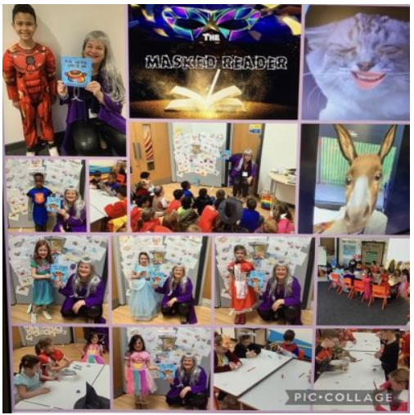

Slide 12
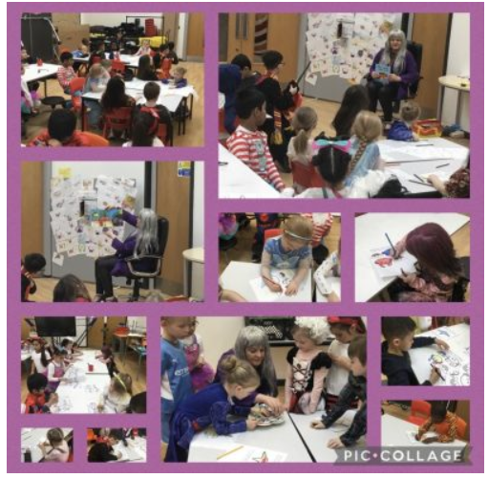

Slide 13
