Slide 1


Key slides from our parent workshop
Hi, I'm Ru from Speech Leap. I'm a Speech and Language Therapist and I have been working with Inspire Academy every week for the past year. I work with children to support their speech, language and communication development. I hold fun and engaging sessions with children 1:1 or in groups. I help train staff to carry out speech and language intervention and give advice to parents and teachers to help their children.

Slide 2

Ages and stages: 3-4 years
Attention: Can listen to and remember longer stories.
Comprehension: Can follow simple instructions and answer ‘who’, ‘what’, ‘where’ and some ‘why’ questions.
Expressive language: Can use longer sentences and beginning to link sentences together (e.g. “and” and “because”). Can describe events that have happened but will make errors with grammar.
Social interaction: Can play with other children and show more complex imaginative play.

Slide 3
Ages and stages: 4-5 years
Attention: Can follow instructions without having to stop and look at the speaker.
Comprehension: Understand more complicated language including sequencing concepts and prepositions (e.g. “first”, “above”, “in between”).
Expressive language: Able to retell a short story and use sentences of greater length.
Social interaction: Start to choose their own friends and take turns in longer conversations.

Slide 4
Be face-to-face
Being face-to-face helps you to:
Connect with your child
See what they are interested in
See the subtle communication messages they may be sending (e.g. looking, smiling, reaching, pointing etc.)
Being face-to-face also helps your child to see and hear your words more easily and read your facial expressions. This will help them understand and learn new words.

Slide 5
Questions and Comments
Questions can actually be ‘conversation stoppers’
Try to avoid asking questions to test during play activities. Make comments instead
Match your language to your child’s level
Talk about the here and now - what they can see, what they are doing, what they are playing with
Comment using a variety of words

Slide 6
Action Words
Action words are important for creating sentences
Action words are harder for children to learn
Play games such as ‘Simon Says’ and encourage your child to act out the word
Comment using specific words that match an activity e.g. Bath time – splashing, pouring
Cooking – mixing, stirring, boiling

Slide 7

Say less
Stress
Show
Go Slow
Then Repeat! Repeat! Repeat!
Notes:
Em
In order to recognize these children we need to know how language develops and what is typical….

Slide 8

Dummies
Dummies can:
Reduce the amount of babbling
Stop children copying words
Lead to difficulties producing sounds
Change the shape of children’s mouth and teeth
Notes:
Reduces the amount of babbling which is a vital stage before children can talk
Dummies can stop your child attempting to copy words and learning to speak
Lots of sounds are produced at the front of the mouth and having a dummy in prevents these from being produced accurately (e.g. p, b, m, n, t, d and s)
Sucking a dummy can often change the shape of your child’s mouth and teeth. Leads to an open bit which doesn’t only affect their baby teeth but also their adult teeth
At this age, they shouldn’t have a dummy at all. Thinking about younger siblings, they don’t need a dummy when they are happy or playing. Only if they are very upset or tired

Slide 9
Dummies
If children don’t have a dummy frequently it will be easier to give up
Limit to nap times and bed times
Only let them have one dummy at a time
Keep it out of sight
Give their dummy to Father Christmas or Easter Bunny
Notes:
Keep it out of sight - – if they see it, they will ask for it
For younger children, gradually fade the dummy out

Slide 10

Technology
Technology is a big part of daily lives, but it can be a distractor to developing good communication skills
Limit screen time before bed and at mealtimes
Turn off the TV or radio in the background
Consider your use of technology (e.g. mobile phones)

Slide 11
Technology
Use technology to spark conversations:
Watch programmes together and talk about the story
Play games together to encourage turn-taking
Link technology to real life activities
Take pictures on days out / holidays. Talk about who was there, where you went and what happened

Slide 12

Importance of books
Books are so important to teach our children new quality words (e.g. oozy, gloopy, petrified etc.)
We need to foster a love of reading before teaching children to read themselves
Bring books to life with facial expressions, gesture, tone of voice, puppets etc.

Slide 13
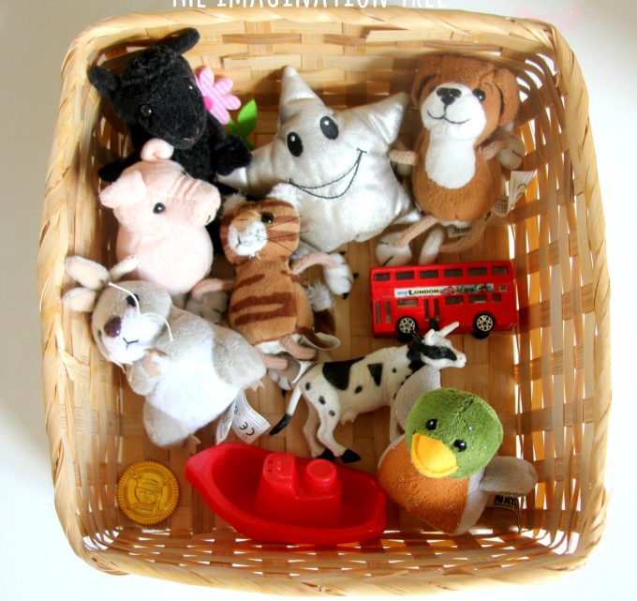
Importance of nursery rhymes
Music brings language to life
Action songs are best
Leave a gap for children to fill in
Good for learning action words

Slide 14



Contact
www.speechleap.co.uk
Ruth@speechleap.co.uk
@SpeechLeapLtd
@LeapSpeech
07423700224
Notes:
Like our facebook page

