Slide 2
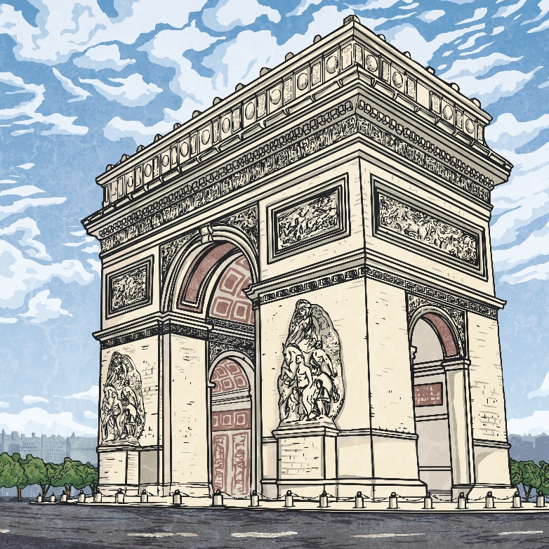
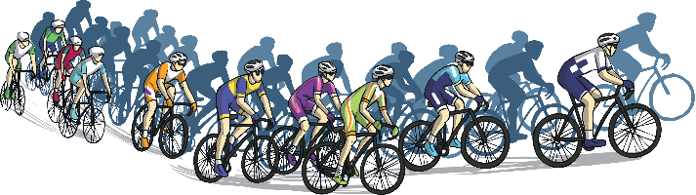
What Is The Tour de France?
The Tour de France is one of the world’s largest annual bicycle events.
Usually held each July and lasting for 3 weeks,
it covers more than 3,300km of flat, hilly and
mountainous terrain across France and
neighbouring countries.
The race started in 1903 and this year will
be the 108th race.
The overall winner of the race is the cyclist
who has ridden the whole route in the
shortest accumulated time.
The route for the Tour de France changes every year but usually finishes at the Champs-Élysées in Paris, as it has done every year since 1975.

Slide 3
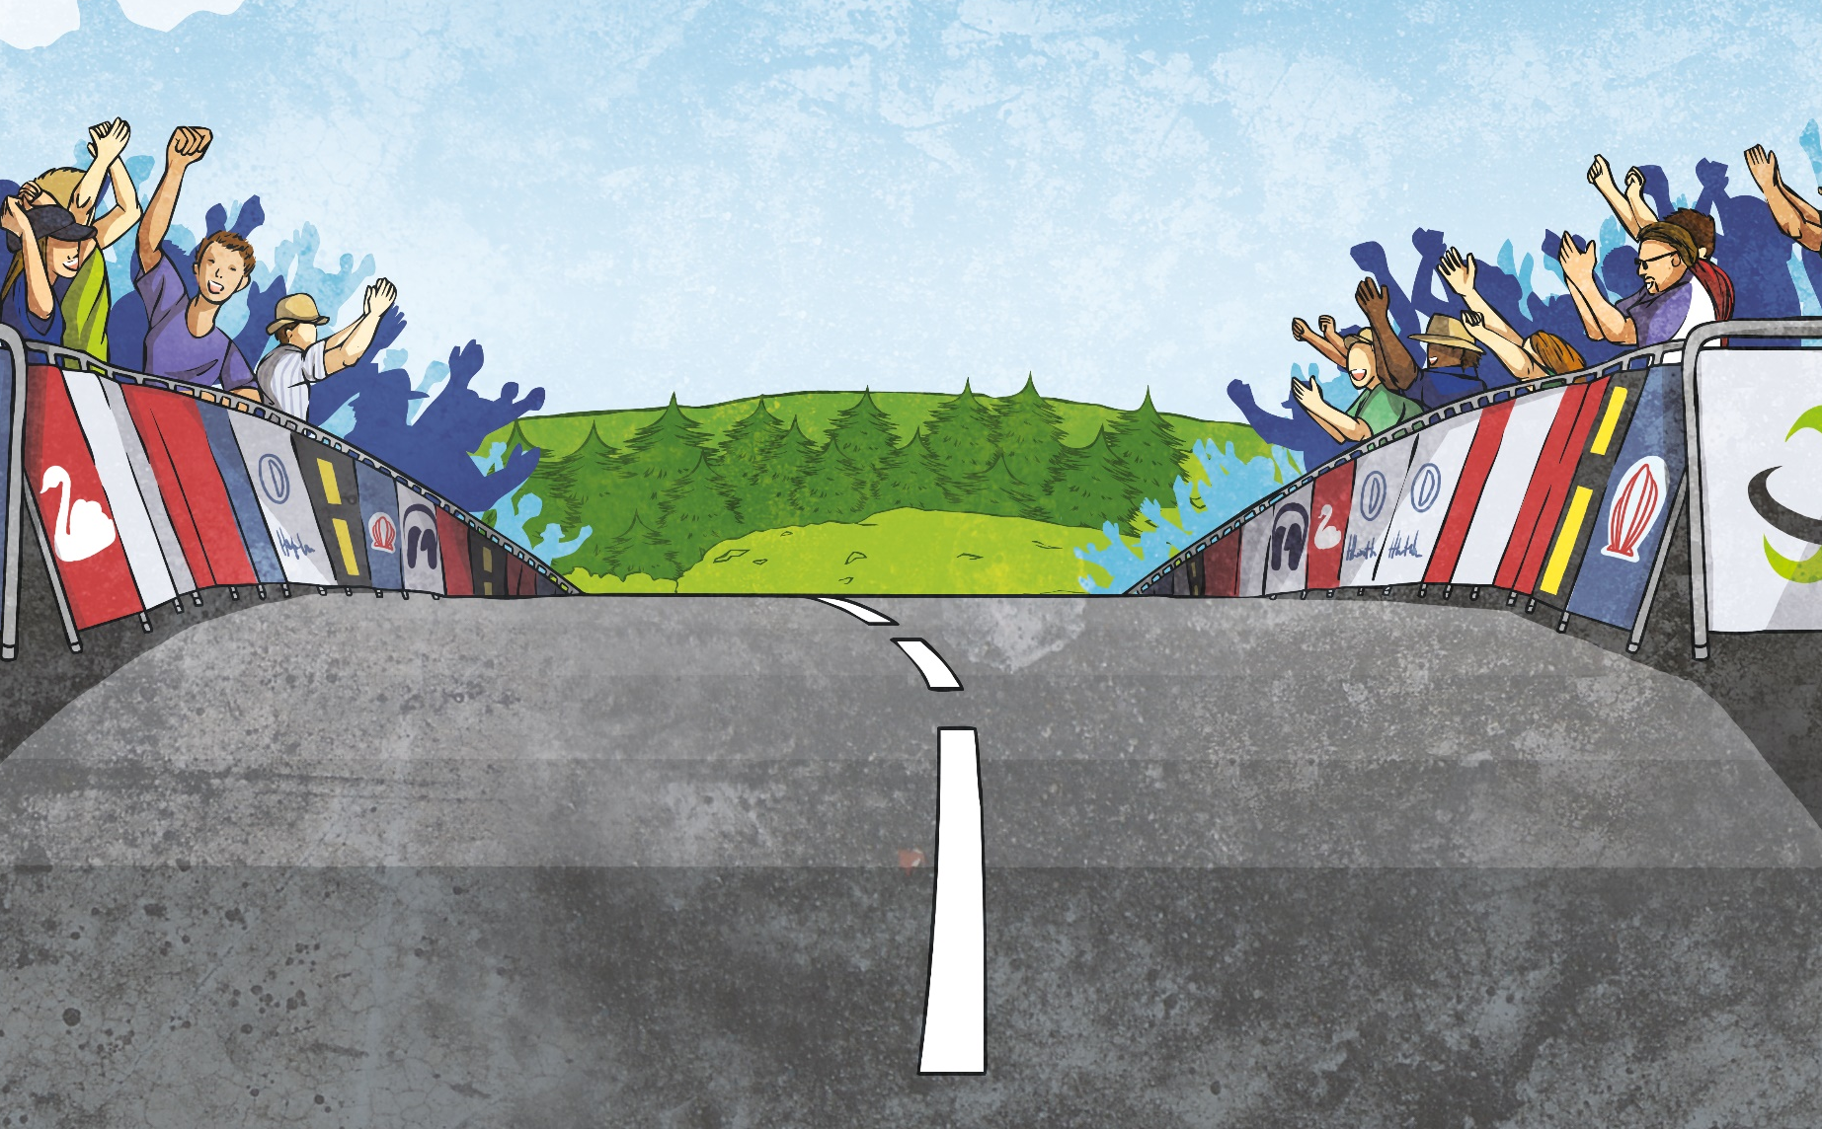
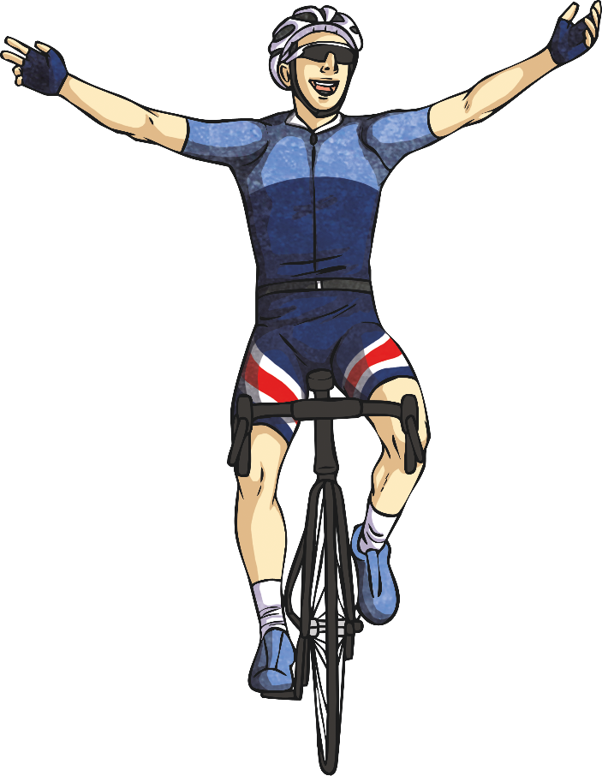
What Is The Tour de France?
Each day, the winner is awarded a coloured jersey to wear for the next stage. It’s fun to spot all the jerseys!
In 2019, the race celebrated 100 years of the yellow winner’s jersey. To mark this, each yellow jersey had a different design that reflected important parts of the race or significant cyclists from the past. They included images of landscapes, buildings and past race winners.

Slide 4
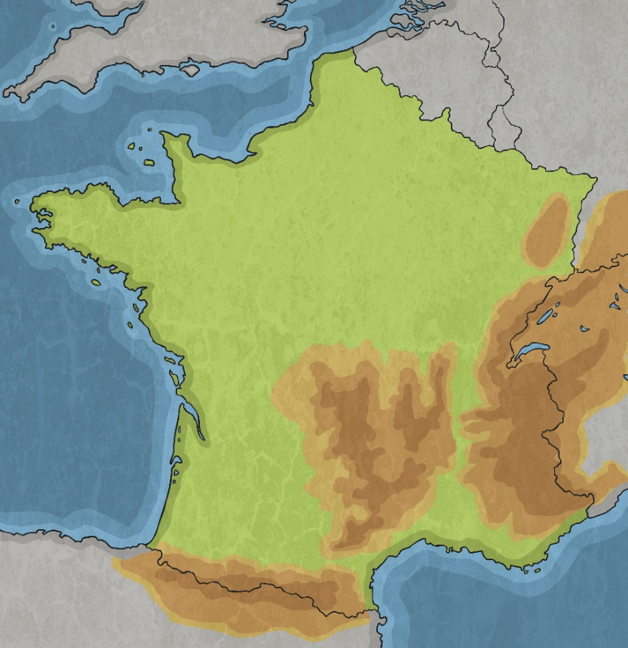
The History of the Race
During the late 19th century, cycling became
a very popular hobby for many people.
As time went on, organised bike racing
was introduced and professional cycling
became especially popular in France.
Sports papers, such as ‘Le Vélo’, sprung
up to cover cycling stories in depth.
‘L’Auto’ was a smaller rival paper, which
was desperate to increase popularity, so one
of its journalists, Géo Lefévre, proposed the
idea of organising a big cycle race through France.

Slide 5
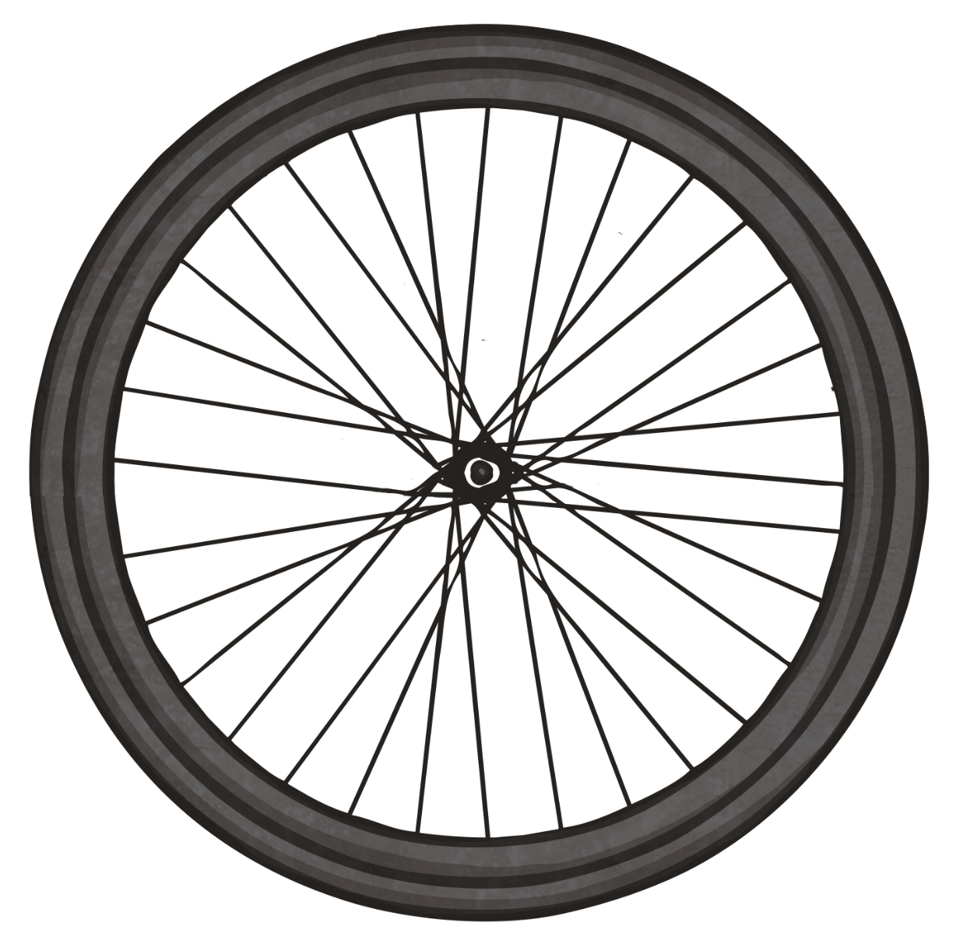

The History of the Race
On the 1st July 1903, 60 cyclists set off from the Au Reveil Matin Café in the suburbs of Paris. They covered 2,428km in a circular route through six stages. 18 days later, 21 of the cyclists made the finish line back in Paris. The physical effort was simply too great for many of the competitors.
The first ever winner was Maurice Garin. Le Tour de France was born! The yellow jersey was introduced as a prize for the winner in 1919 due to the fact that ‘L’Auto’ newspaper was printed on yellow paper.
The race has taken place each year since
then, except for during the wars. As the
tour became more popular, the course
became longer and more challenging
mountain climbs were introduced.

Slide 6
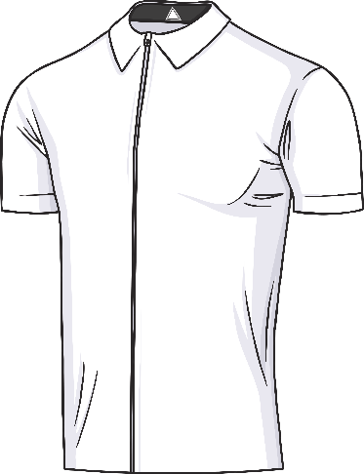
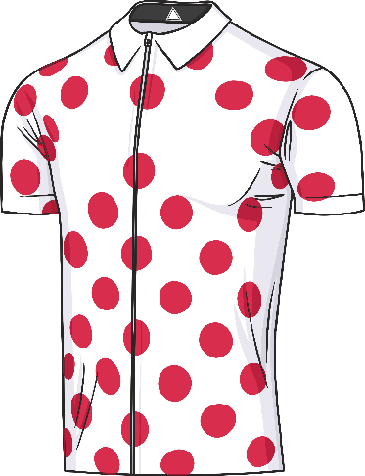
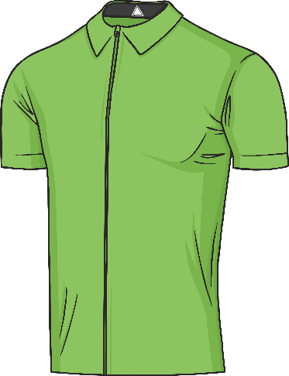
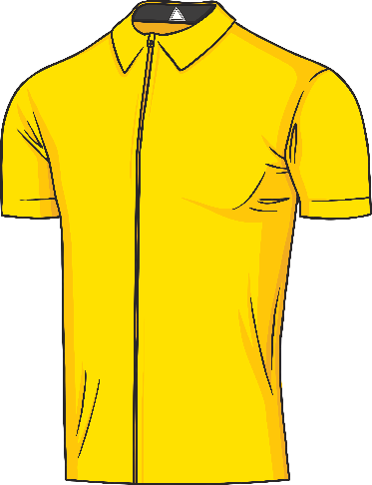
Jerseys
Instead of winning medals or awards, the cyclists participating in the Tour de France win different coloured jerseys.
The White Jersey
The white jersey is awarded to the best young rider (under 26 years old).
The Polka-Dot Jersey
The polka-dot jersey is awarded to the best climber or ‘King of the Mountains’
The Green Jersey
The green jersey is awarded to the best sprinter and time trialist.
The Yellow Jersey
The oldest and most sought-after prize: the yellow jersey is awarded to the rider with the quickest overall time.

Slide 7
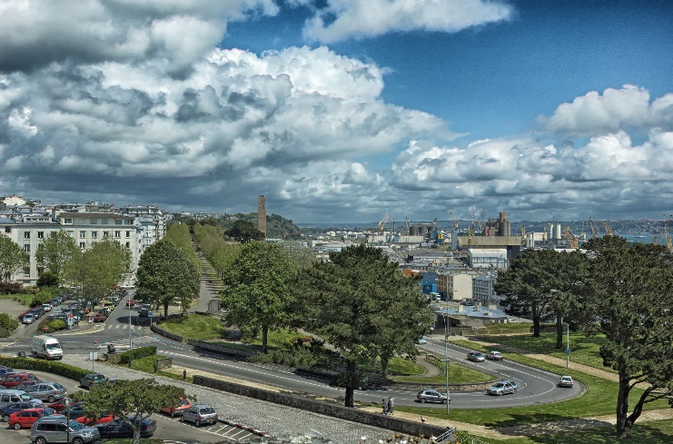
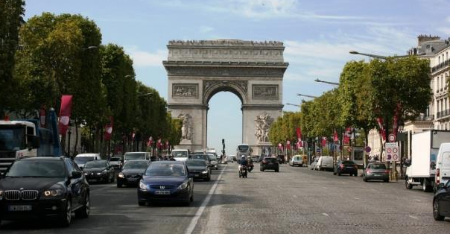
The Tour de France 2021
Each year, the Tour de France begins in a different place, often in one of France’s neighbouring countries. This is known as the Grand Départ.
In 2021, the Grand Départ will take place in Brest, France on 26th June. It is the fourth time Brest has hosted the start of the race.
The Start (Le Grand Départ): Brest, France
The Finish:
Champs-Élysées Avenue, Paris

Slide 8
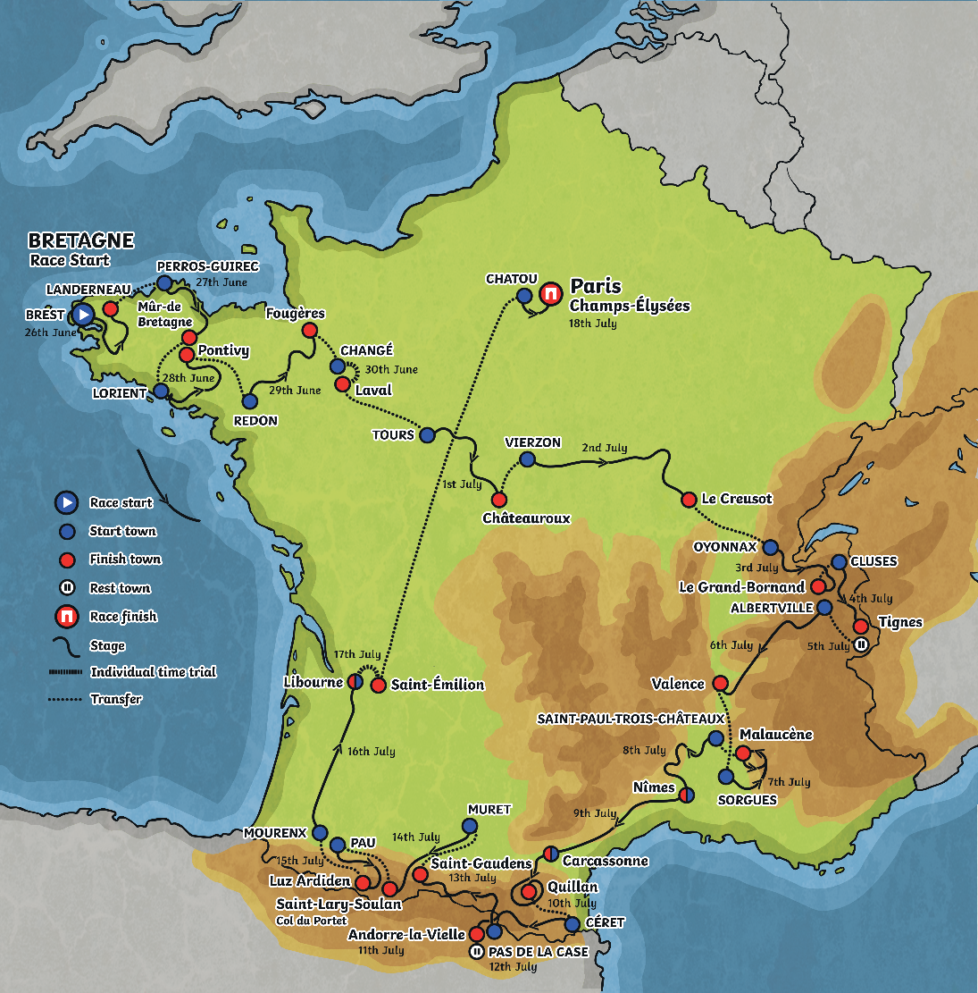
Tour de France Route - Stages
The race consists of 21 stages, this year covering 3383 km (2102 miles) in total. Each stage lasts
one day.
In 2021, there will be eight flat stages, five hilly stages, six mountain stages plus two individual time-trials.
Within the 23 days of
the race are just two
days of rest.

Slide 9

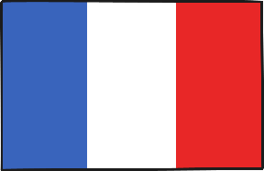

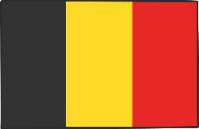
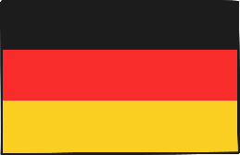
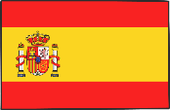
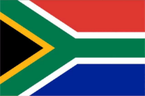
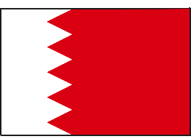

2021 Teams
Each year, numerous teams made up from riders from around the world take part in the Tour de France.
Here are just a few of the teams that will be racing:
Ineos Grenadiers
Great Britain
AG2R Citroën Team
France
Astana – Premier Tech
Kazakhstan
Lotto Soudal
Belgium
Bora – Hansgrohe
Germany
Movistar Team
Spain
Team Qhubeka Assos
South Africa
Bahrain Victorious
Bahrain
EF Education- NIPPO
USA

Slide 10
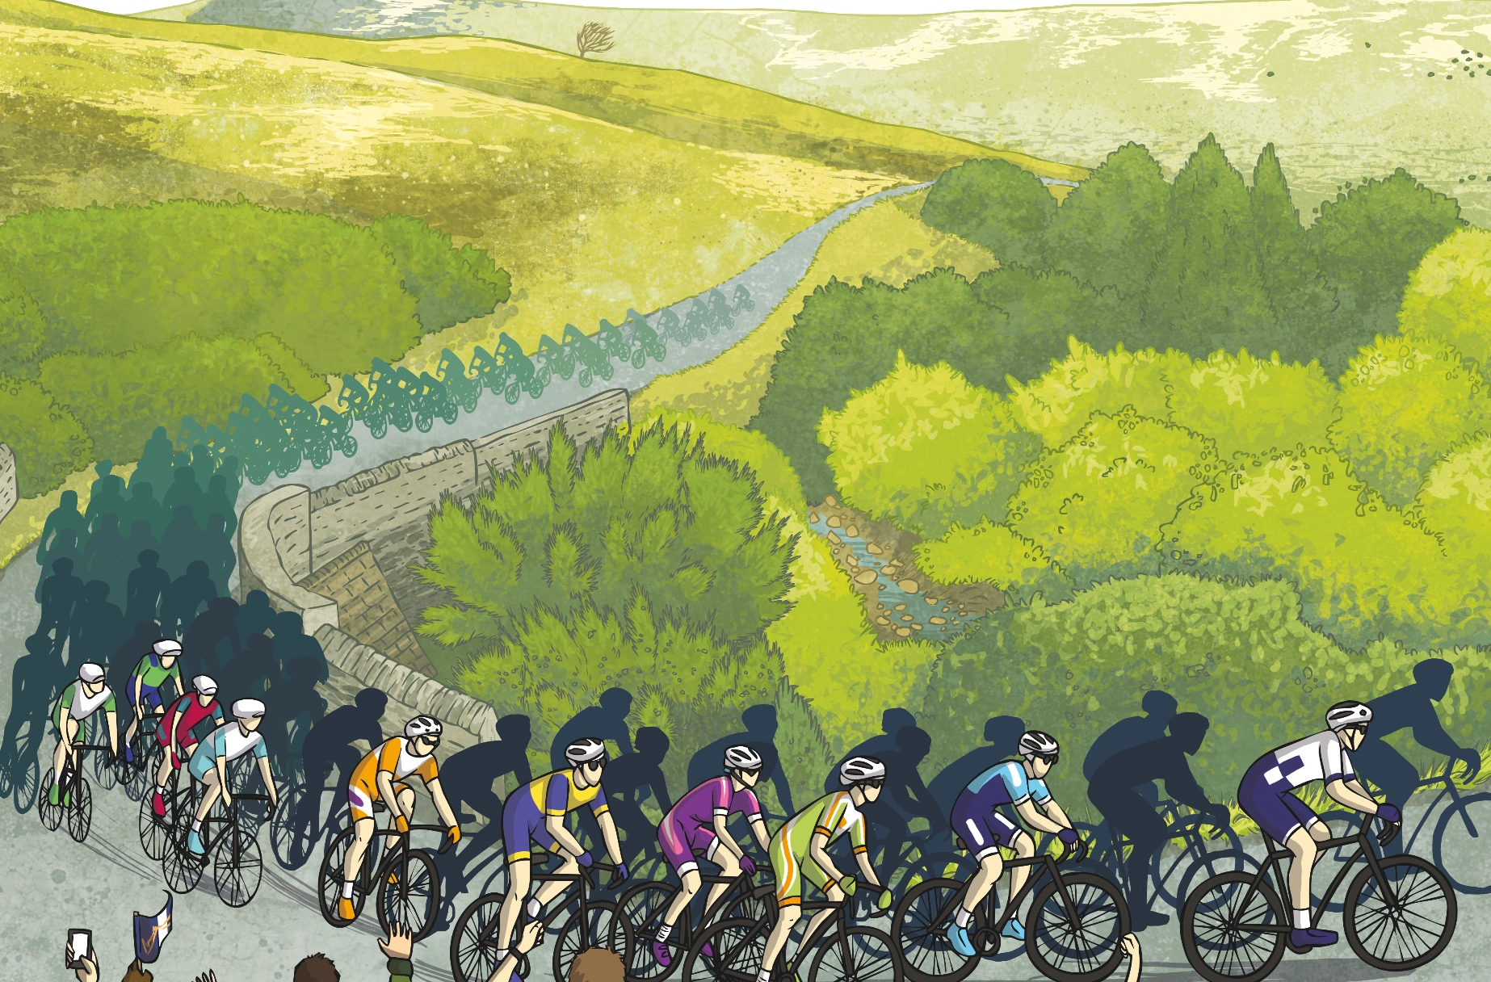
Facts
Le Grand Départ is usually held outside of France. However, this year it is being held inside France because of the COVID-19 pandemic.
In 2014, the Tour de France began in Leeds, Yorkshire in the UK. Riders raced through York, Sheffield and Harrogate, then from Cambridge to London, before continuing the race in France.
The riders and their teams have to travel by aeroplane to some stages.
The Tour de France attracts 15 million spectators across the route.

Slide 11
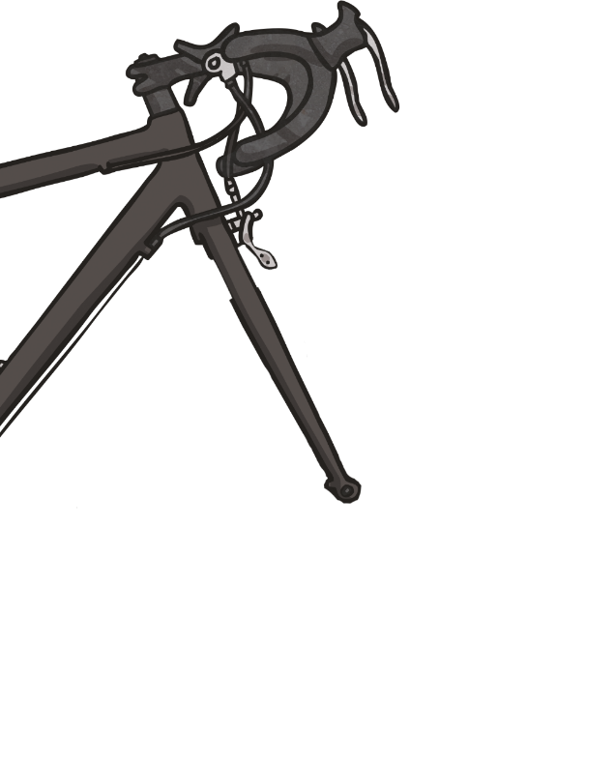

Facts
  1,200 hotel rooms are reserved each night for
  the teams and their staff.
          Bradley Wiggins became the first ever British rider to win the Tour de France in 2012. Chris Froome, also from Britain, then won the race in
          2013, 2015, 2016 and 2017!
                In 2018, Geraint Thomas became the first Welsh person to win and in 2019, he came second.
The 2020 winner was Tadej Pogačar from Slovenia.
Aged 22, he was the youngest winner of the
Tour de France since 1909.

Slide 12

Your task
Be creative with your design and colours.
I can’t wait to see them!

