Slide 1
Session 3: Using the cipher to create and crack codes
To use the cipher to create and crack codes

Slide 2
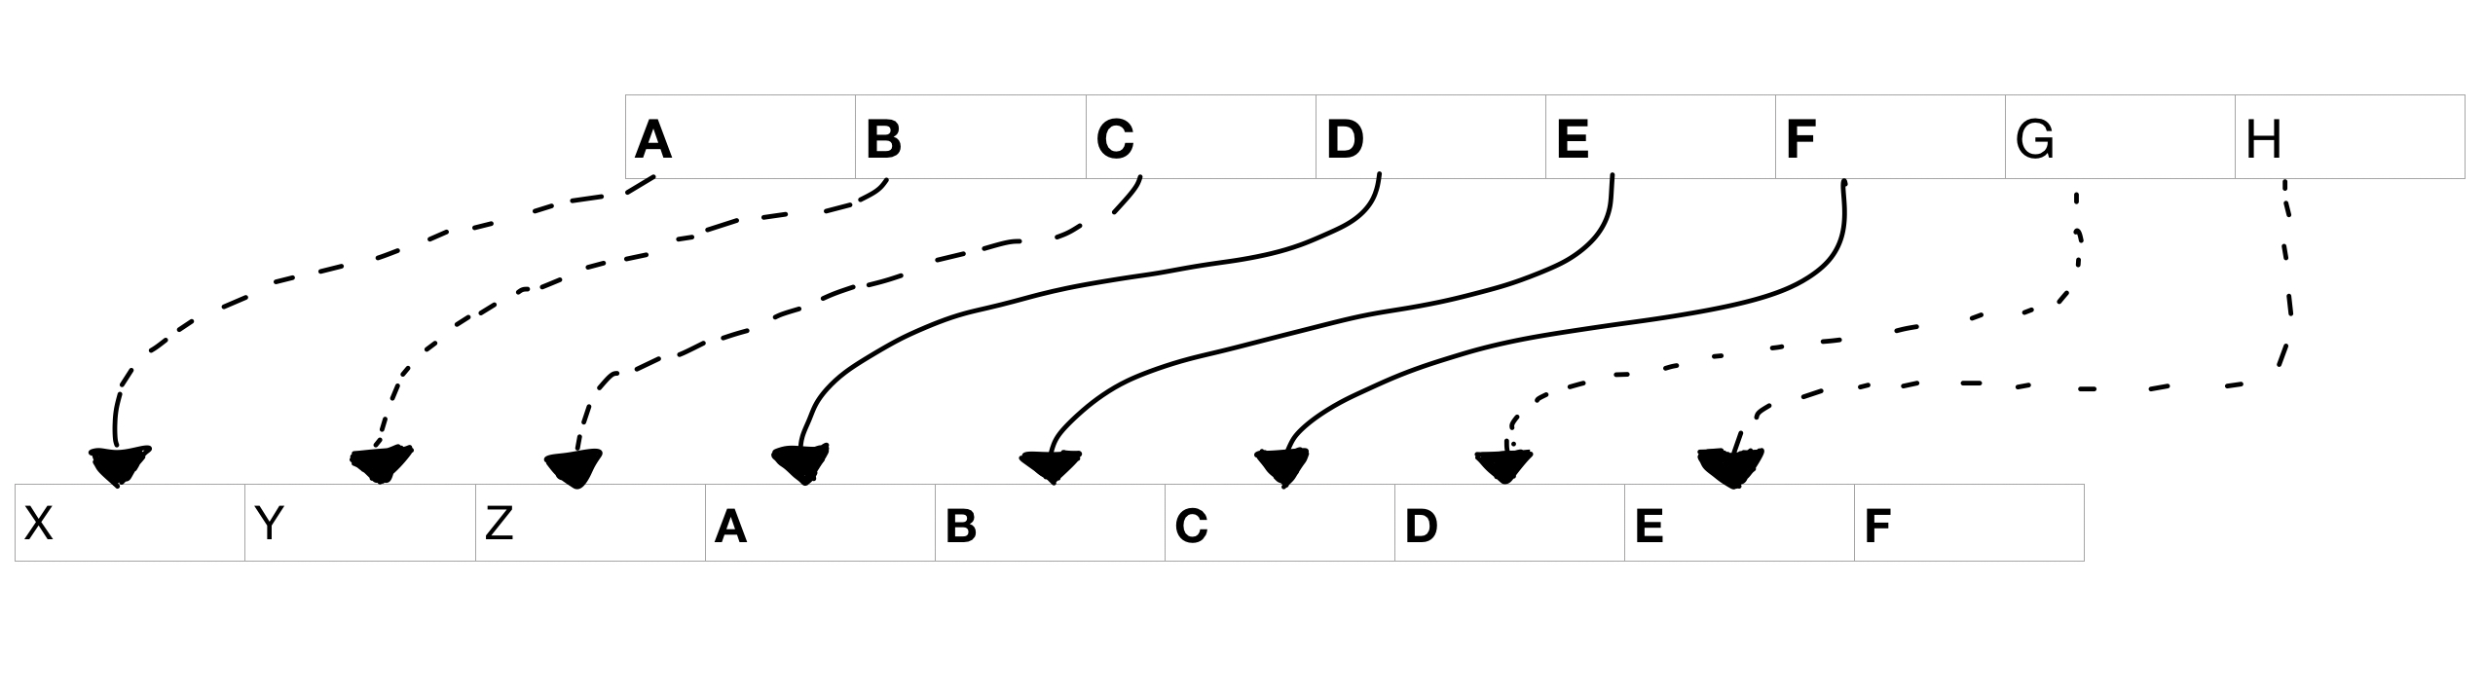
Let’s learn
In this session, you will learn about ciphers and decode messages. You will explain the cipher as an algorithm, outlining the steps to crack the code.
This cipher is where each letter of the alphabet is substituted by another letter being shifted a certain number of positions along the alphabet.
Do you know what a cipher is?
Click on this box to see the definition.
Cipher: an agreed scheme (algorithm) for
encrypting or decrypting a message

Slide 3
Let’s discuss
How might you transmit a secret message using semaphore or Morse code?
One possibility is agreeing on a cipher with the person receiving the message. For example, each letter would be shifted once along in the alphabet.
HELLO
IFMMP
A | B | C | D | E | F | G | H | I | J | K | L | M
B | C | D | E | F | G | H | I | J | K | L | M | N
N | O | P | Q | R | S | T | U | V | W | X | Y | Z
O | P | Q | R | S | T | U | V | W | X | Y | Z | A
What would IFMMP mean?
Click to find out!

Slide 4
Let’s try
Can you decode this message using the cipher where each letter of the alphabet has been moved one space to the right?
Answer on the next slide!
EJOPTBRS
A | B | C | D | E | F | G | H | I | J | K | L | M
B | C | D | E | F | G | H | I | J | K | L | M | N
N | O | P | Q | R | S | T | U | V | W | X | Y | Z
O | P | Q | R | S | T | U | V | W | X | Y | Z | A

Slide 5

EJOPTBRS
DINOSAUR

Slide 6
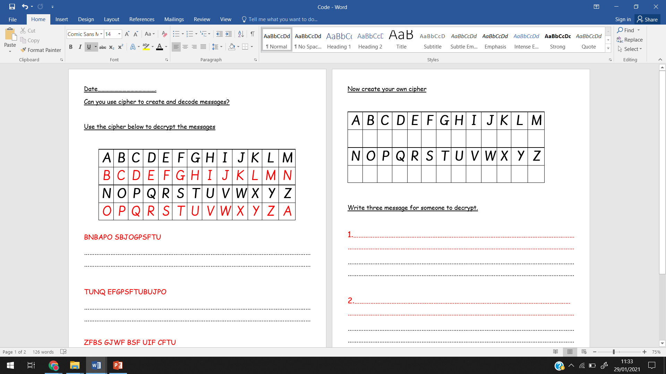
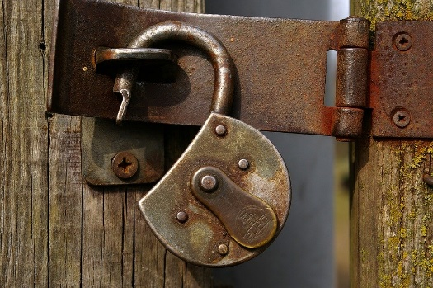
Task- Use the cipher to decrypt the message.
You will find the sheets on the home learning site.
Do you know what a decrypt means?
Click on this box to see the definition.
Decrypt: to convert an encrypted message into readable text

Slide 7
Challenge- Create your own cipher and messages for someone to decode.
Ask someone in your house to decode the message or email it to your friends or teachers on purple mash.

