Slide 1
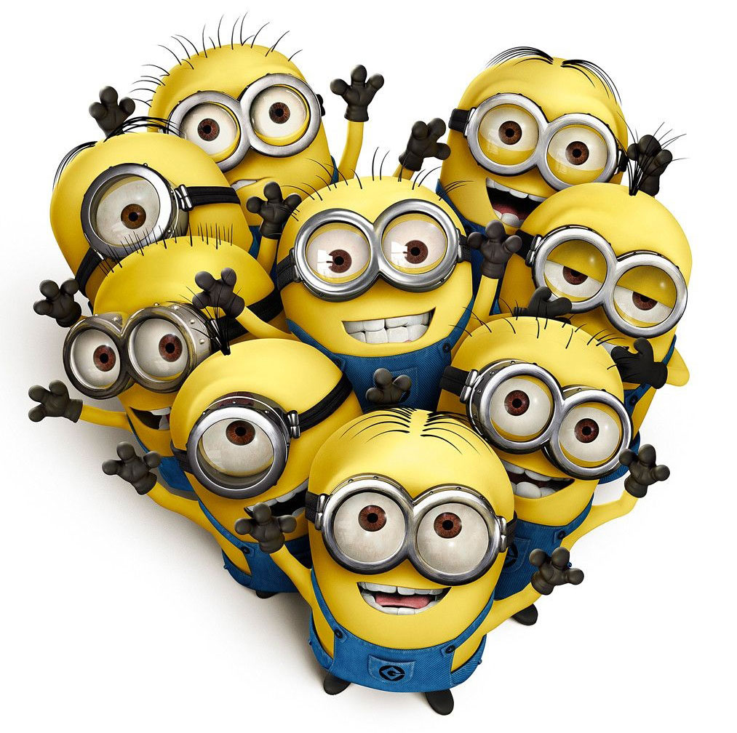
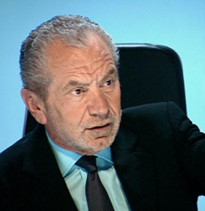
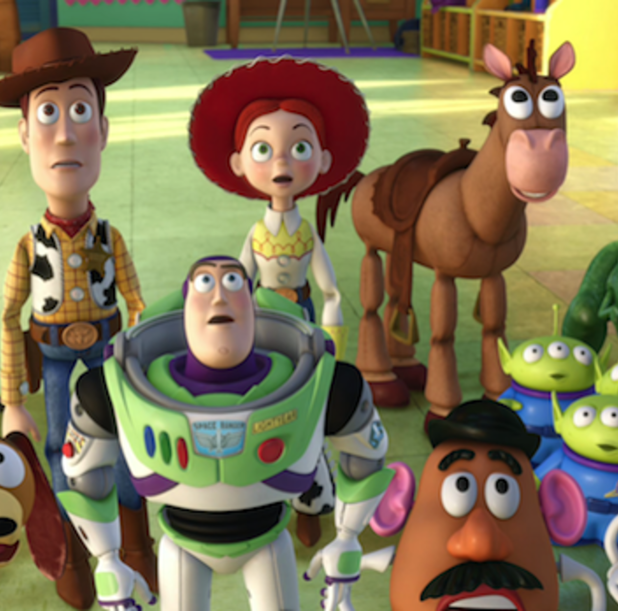

What do these three pictures have in common?

Slide 2


What did you think?
Share your thoughts.

Slide 3
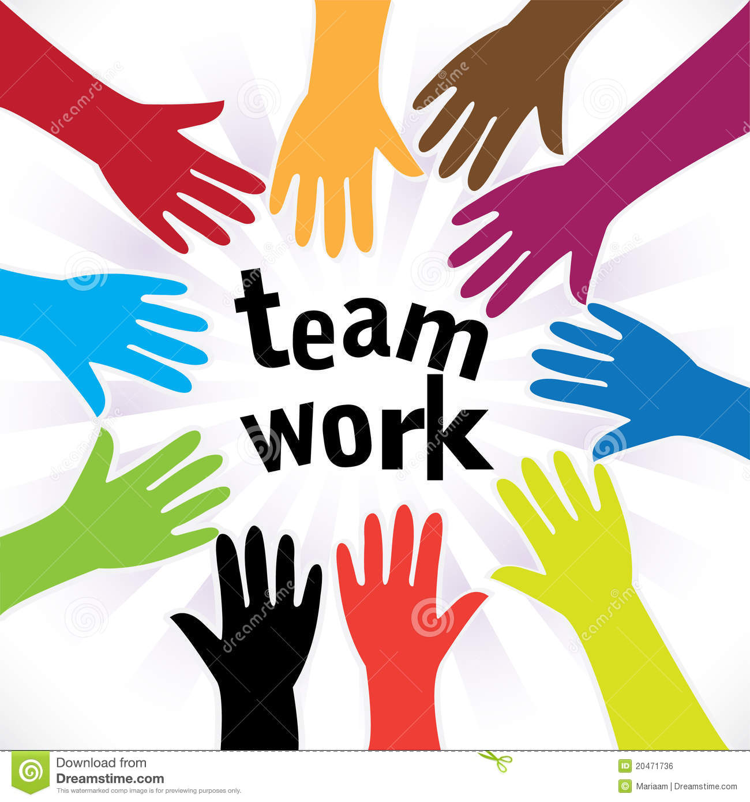

Slide 4
Think about these questions…
Can you play a game of ludo by yourself?
Which is more important? a) Work well as a team and not complete your task b) Work by yourself and finish your task
Explain your answer. You can discuss this with your partner or write it down.

Slide 5
I can understand how my behaviour impacts a group.
Teamwork makes the dream work.
What do you think this means?
What role do you have as a team member?
Share your thoughts with an adult or you can write them down.

Slide 6
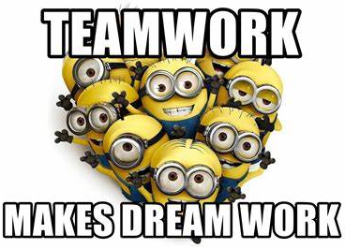
Did you include any of these words in your discussion?
Rights
Responsibility
Rewards
Consequences
Cooperation
Collaboration
How many did you include?

Slide 7
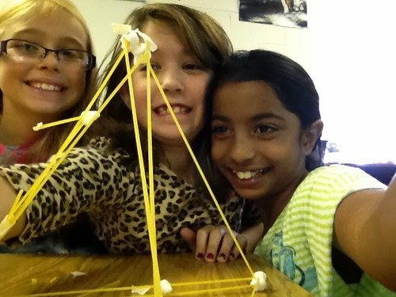
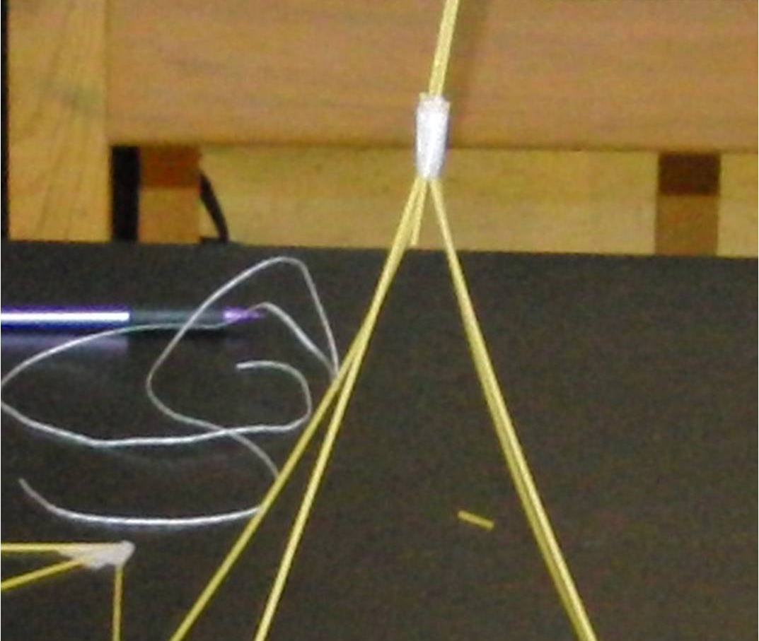
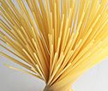
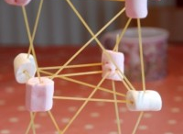
Your challenge today is to make the tallest structure using dry spaghetti and blu tack.
Think about who will do what in your groups.
You have 5 minutes…Good luck!

