Slide 1
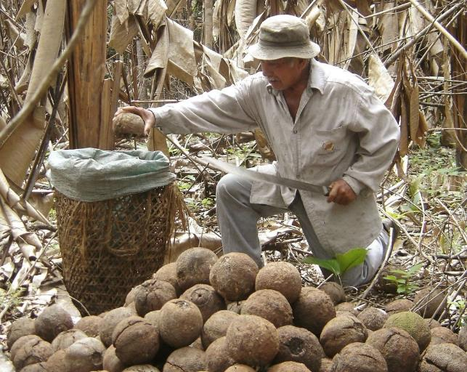
What is this man collecting?
Notes:
Introduce this lesson by asking the students what they think the picture shows. Point to the pods in the bottom half of the picture and ask what students think they are.
If they are unsure, take some guesses and then move on to the next slide.
What you will need for this lesson: 16.5 metres of string tied into a circle

Slide 2
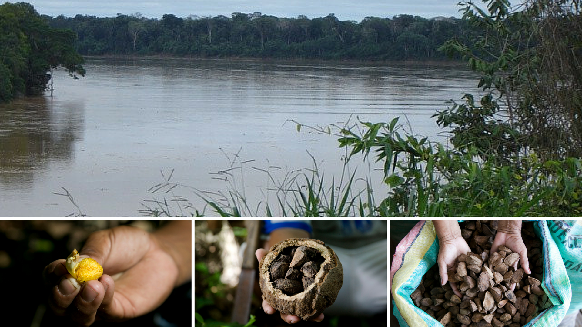
Notes:
Keep taking guesses using this picture if students have not guessed yet.
© Eduardo Martino

Slide 3
The Brazil Nut Story
With thanks to
the world’s first and only
farmer-owned Fairtrade nut company
Notes:
The answer is Brazil nuts – this lesson is all about where Brazil nuts come from, how they are gathered and how Fairtrade can help Brazil nut gatherers to get a better deal for their work.

Slide 4
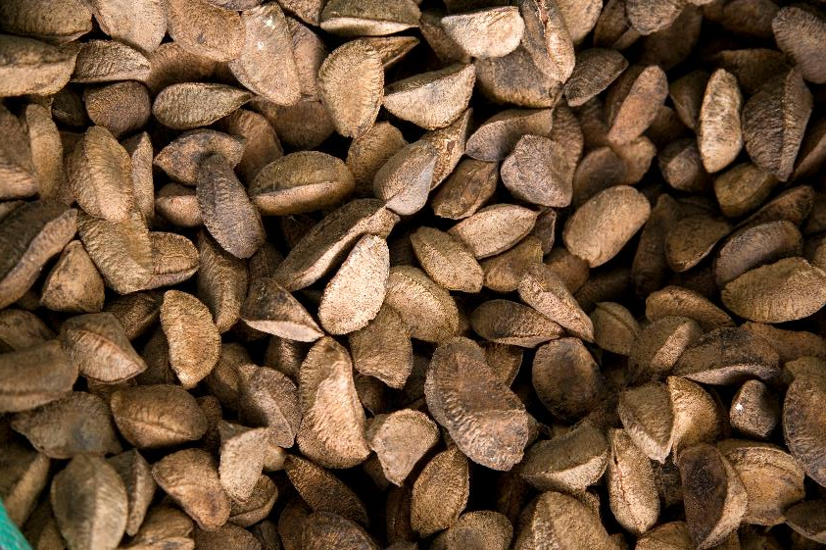
In this lesson we will:
Learn where and how Brazil nuts are grown and gathered
Look at the rainforest and the factors needed to grow Brazil nuts
Talk about Fairtrade and how it can help Brazil nut gatherers to get a better deal

Slide 5
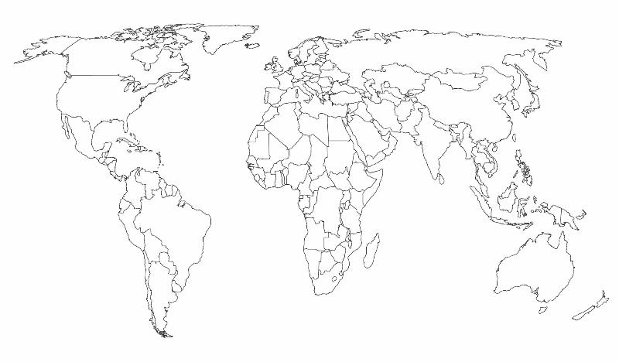

Despite the name, the journey of many Brazil nuts begins in Bolivia…
UK
Bolivia
Notes:
Bolivia is in South America.
Fairtrade Brazil nuts come from the northern region of Bolivia, from part of the Amazon Rainforest.
The weather is tropical and humid, as it is near the Equator.
[point out the line across the map where the Equator runs across the top of Brazil, through DRC and the middle of Uganda and Kenya and Indonesia]

Slide 6
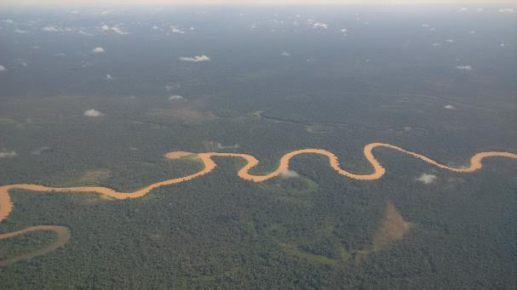
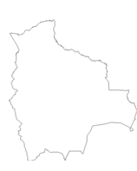
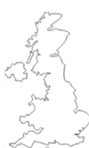

Bolivia Fact-book:
Capital: La Paz
Population: 10.8 million
Over 38% of population live below the national poverty line
The landscape is very varied and includes:
The Amazon Rainforest
The Amazon River
The Andes
Lake Titicaca
Salt flats
Bolivia is 4 and a half times the size of the UK
=
+
+
+
+
Notes:
As an extended piece of work students could research the different environmental areas in Bolivia and write a sentence about each one:
The Amazon River
The Amazon Rainforest
The Andes
Lake Titicaca
Salt flats
The focus for the rest of the presentation is the rainforest as this is where most Brazil nuts grow.

Slide 7
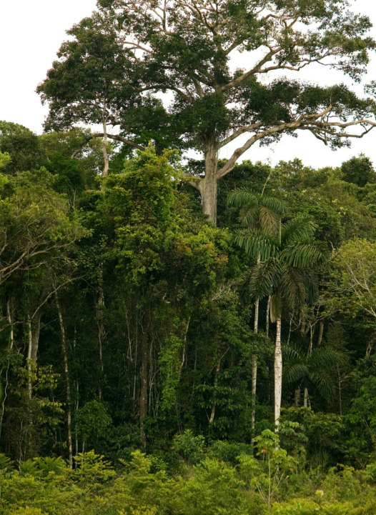
The Rainforest
Split into four ‘layers’
Rainforest covers 6% of Earth’s surface but contains more than half of our plant and animal species
Characterised by lot of rain and high temperatures (27-32C)
Which layer do you think the Brazil nut grows in?
The Emergent Layer (over 30m)
The Canopy (20 - 30m)
The Understory (5 – 20m)
The Forest Floor (under 5m)
Notes:
The rainforest is split into four ‘layers’:
The Emergent Layer
The Canopy
The Understory
The Forest Floor
Further work:
Download the Rainforest Activity and print one for each student.
Ask pupils to label each layer on the diagram and draw in plants, animals and birds that might be found at each level, starting with the Brazil nut tree in the Emergent Layer.

Slide 8
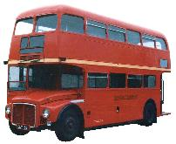
The Brazil nut tree
Is
Up to
50m
high!
Notes:
Brazil nut trees grow mostly in the Amazon Rainforest.
Brazil nuts grow towards the top of Brazil nut trees. The trees can be roughly 50 metres tall - that’s taller than three double-decker buses.
It takes about 14 months for the fruit to mature after pollination. It then falls from the tree. This is a very long way for the pods to fall!
This makes them very difficult to harvest.

Slide 9
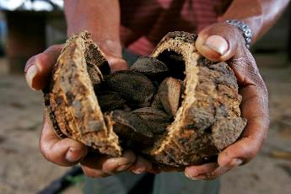
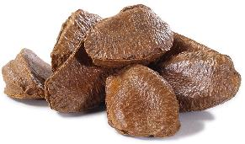
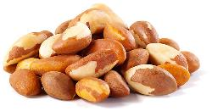
The Brazil nut: It’s not a nut and it’s often not from Brazil…
The woody seed capsule is technically the ‘nut’
What we call the nut is technically the ‘seed’
Notes:
So far we have learnt that most Brazil nuts actually come from Bolivia and not Brazil.
Interestingly the Brazil nut is not strictly a ‘nut’ either.
What we know as Brazil nuts come in individual shells, all crammed into a round woody seed capsule.
The seed capsule is actually the ‘nut’ and what we would call the nut is in fact the ‘seed’.
There are 20 – 30 ‘seeds’ inside each ‘nut’ (or 20-30 Brazil nuts as we call them inside each woody capsule)
Roughly half the world’s Brazil nuts come from Bolivia, 40% come from Brazil and 10% are from Peru.
(Note: For the rest of the presentation we will continue to speak of the Brazil nut as the individual shelled part of the nut that we would eat)

Slide 10
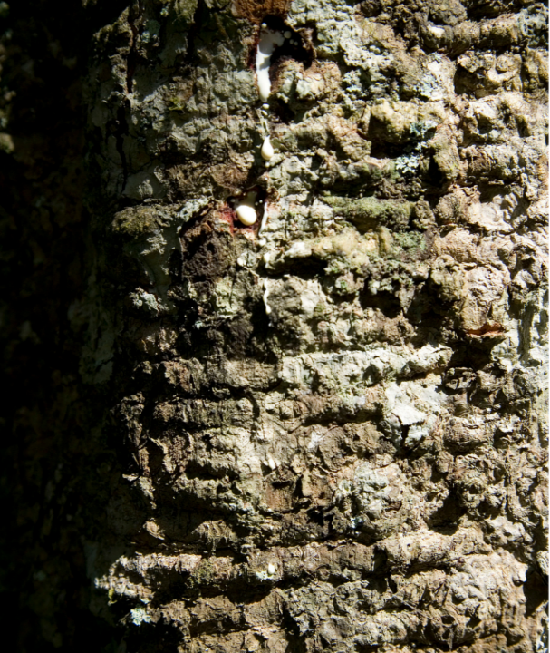
Notes:
The trunk of a Brazil nut tree can be 16.5m in circumference.
Activity: Show 16.5m with a length of string tied in a circle. You could see how many students fit within the circle to show how thick the trunk of a Brazil nut tree can be or see how many children can hold hands around the circumference.
If you do not have an opportunity to do this you could explain that 16.5m is twice the length of a double-decker bus.

Slide 11
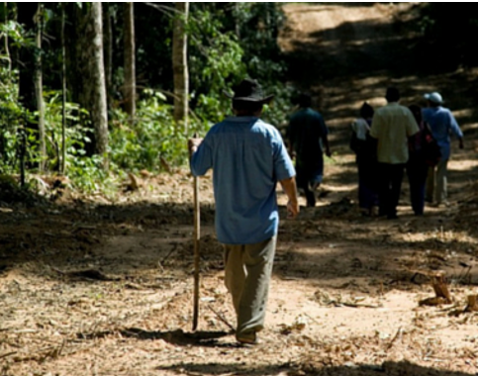
The Brazil nut can only be collected from the wild. The trees are too tall to climb and gatherers must wait for the nuts to fall from the tree.
Gatherers go on collection trips, camping in the rainforest for days or weeks at a time.
Notes:
Brazil nuts are not ‘farmed’ like other crops.
They only grow in parts of the rainforest and must be collected once the pods have fallen to the floor.

Slide 12
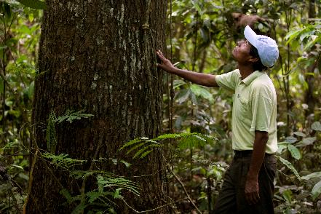
Dangerous work
The seed capsules can fall 50m to the forest floor and some weigh the same as a large pineapple.
This makes it very dangerous to walk under the trees in case they fall.
If the wind changes, gatherers have to stop collecting the Brazil nut pods and move away from the trees.
The rainforest is also home to many dangerous animals such as snakes and jaguars.

Slide 13
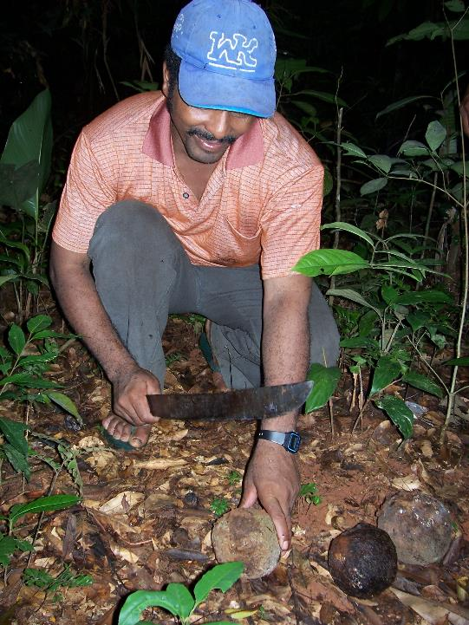
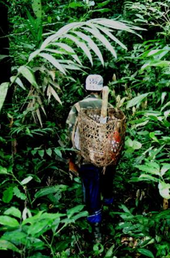
The pods are cracked open with machetes in the forest and the individual Brazil nuts are emptied into baskets to be carried home. This saves carrying the extra weight of the pod.

Slide 14
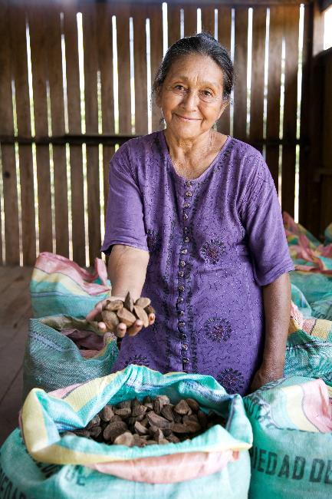
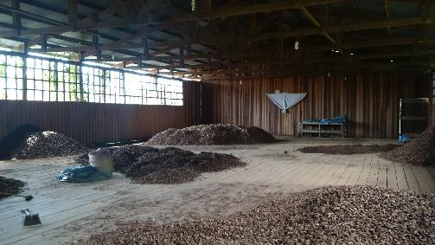
Back in the communities, the Brazil nuts are stored in wooden huts called ‘paioles’ and put in sacks.
Notes:
The picture in the top right is a ‘paiole’ – a large wooden hut where the Brazil nuts are stored.

Slide 15
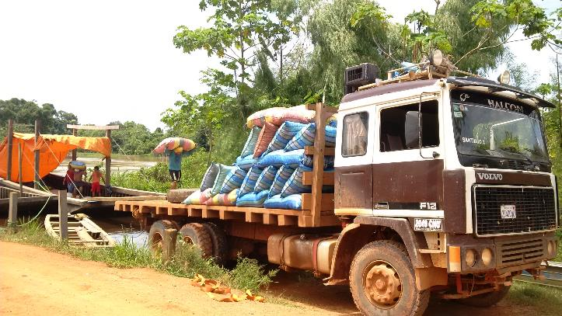
These gatherers are part of a Fairtrade co-operative called COINACAPA so their sacks are then transported from the villages to the co-operative by horse, boat or motorbike to be processed together.

Slide 16
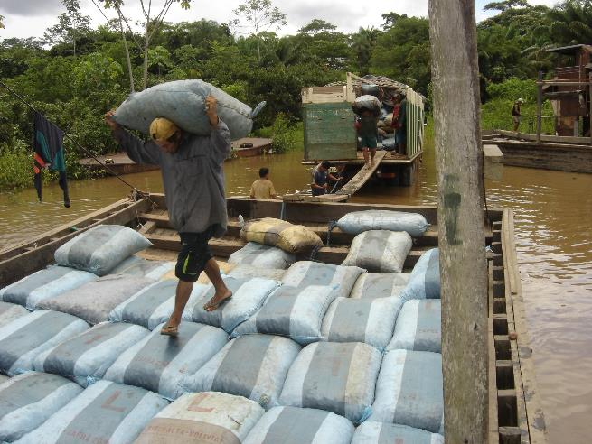
The rainy season starts at the end of gathering season so it is a race against time to pack and transport the Brazil nuts.
Climate change is making the rains more unpredictable.

Slide 17
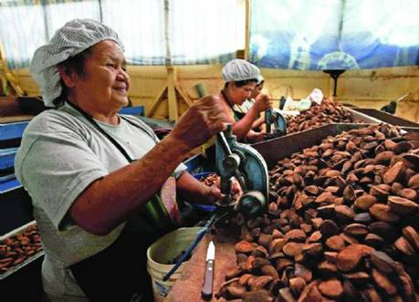
At the co-operative the Brazil nuts are dried on a wooden floor and go on to the factory to be cracked and packaged.
Selling as part of a Fairtrade co-operative means that the gatherers can get a better price for their hard work.

Slide 18
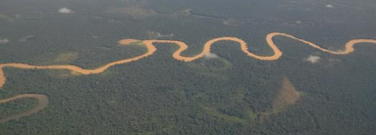
Challenges
The work is dangerous and physically hard.
The areas are very rural so communication between gathering communities is difficult.
It relies a lot on certain areas of the rainforest remaining untouched and protected from logging.
Flooding at the end of the gathering season can make it difficult to transport the nuts.
Notes:
It is very difficult work gathering Brazil nuts. It is dangerous and physically hard.
Further discussion: To follow up on the third point – that Brazil nut tree gatherers rely on pristine areas of the rainforest you may like to mention the delicate balance required for Brazil Nuts trees to grow. There are some points on this in the Teachers’ Notes.

Slide 19

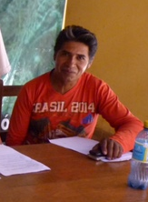
What difference does Fairtrade make?
By working together as a Fairtrade co-operative the gatherers can sell more Brazil nuts at a better price.
Gatherers get the Fairtrade Premium – the extra bit of money for the co-operative to spend on the community or improving their work.
“One of my children now goes to university and I’m very proud. What’s more, the premium has helped improve local housing and we are very thankful for that.”
Julian Perez Ortiz
President of Coinacapa, Brazil nut co-operative
Notes:
By selling as part of a Fairtrade co-operative, gatherers have more power to negotiate better prices and access to information about the market i.e. prices and quality requirements.
Previously an individual gatherer would sell to a trader who came to his or her community and would have to believe what the trader told him about prices that season.
As members of a co-operative the gatherers can pool their resources to collectively market their produce – so the co-operative manager is able to talk directly to export customers and know what the market will pay and what quality is required.

Slide 20

The extra money from Fairtrade has been spent on:
Tools and equipment to carefully clear paths to the best Brazil nut trees in the jungle
Opportunities for community children to go to secondary school and get university education
Healthcare insurance to pay for medical care
Storage facilities to keep nuts in the best condition during and after gathering
Fixing motor bikes, tractors, trucks and boats to transport Brazil nuts out of the jungle

Slide 21
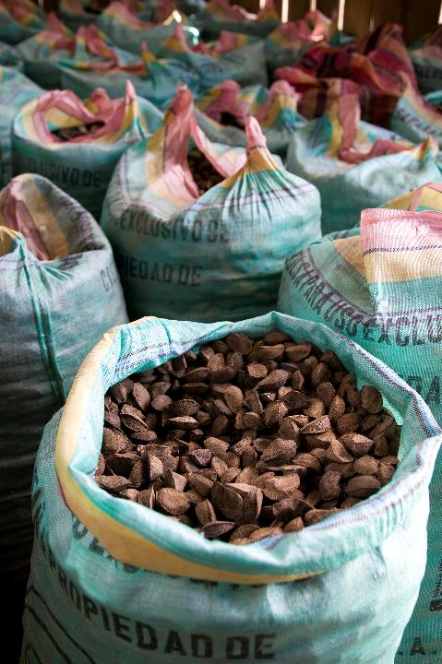
“Before Fairtrade, we sold to local middlemen. If someone needed to go to the doctor they would have to borrow money from the owner of the land and then be in their debt”
Casildo, COINACAPA member

Slide 22
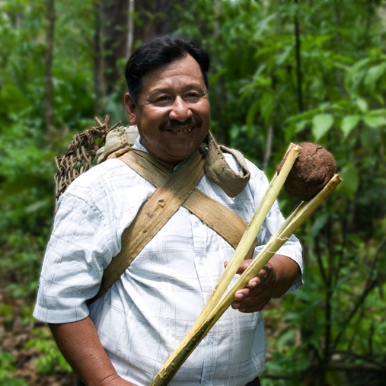
“Since we started the co-operative it’s as if we’ve gained our freedom. It feels like we’re not slaves any more. We have more income, more work and more dignity”.
Juan, COINACAPA member

Slide 23
Task- Using digimaps, Can you find Bolivia on the world map and add pictures and facts about what you have learnt about the Brazil nut?
If you are finding it difficult to use digimaps, create a poster to show what you have learnt.

Slide 24
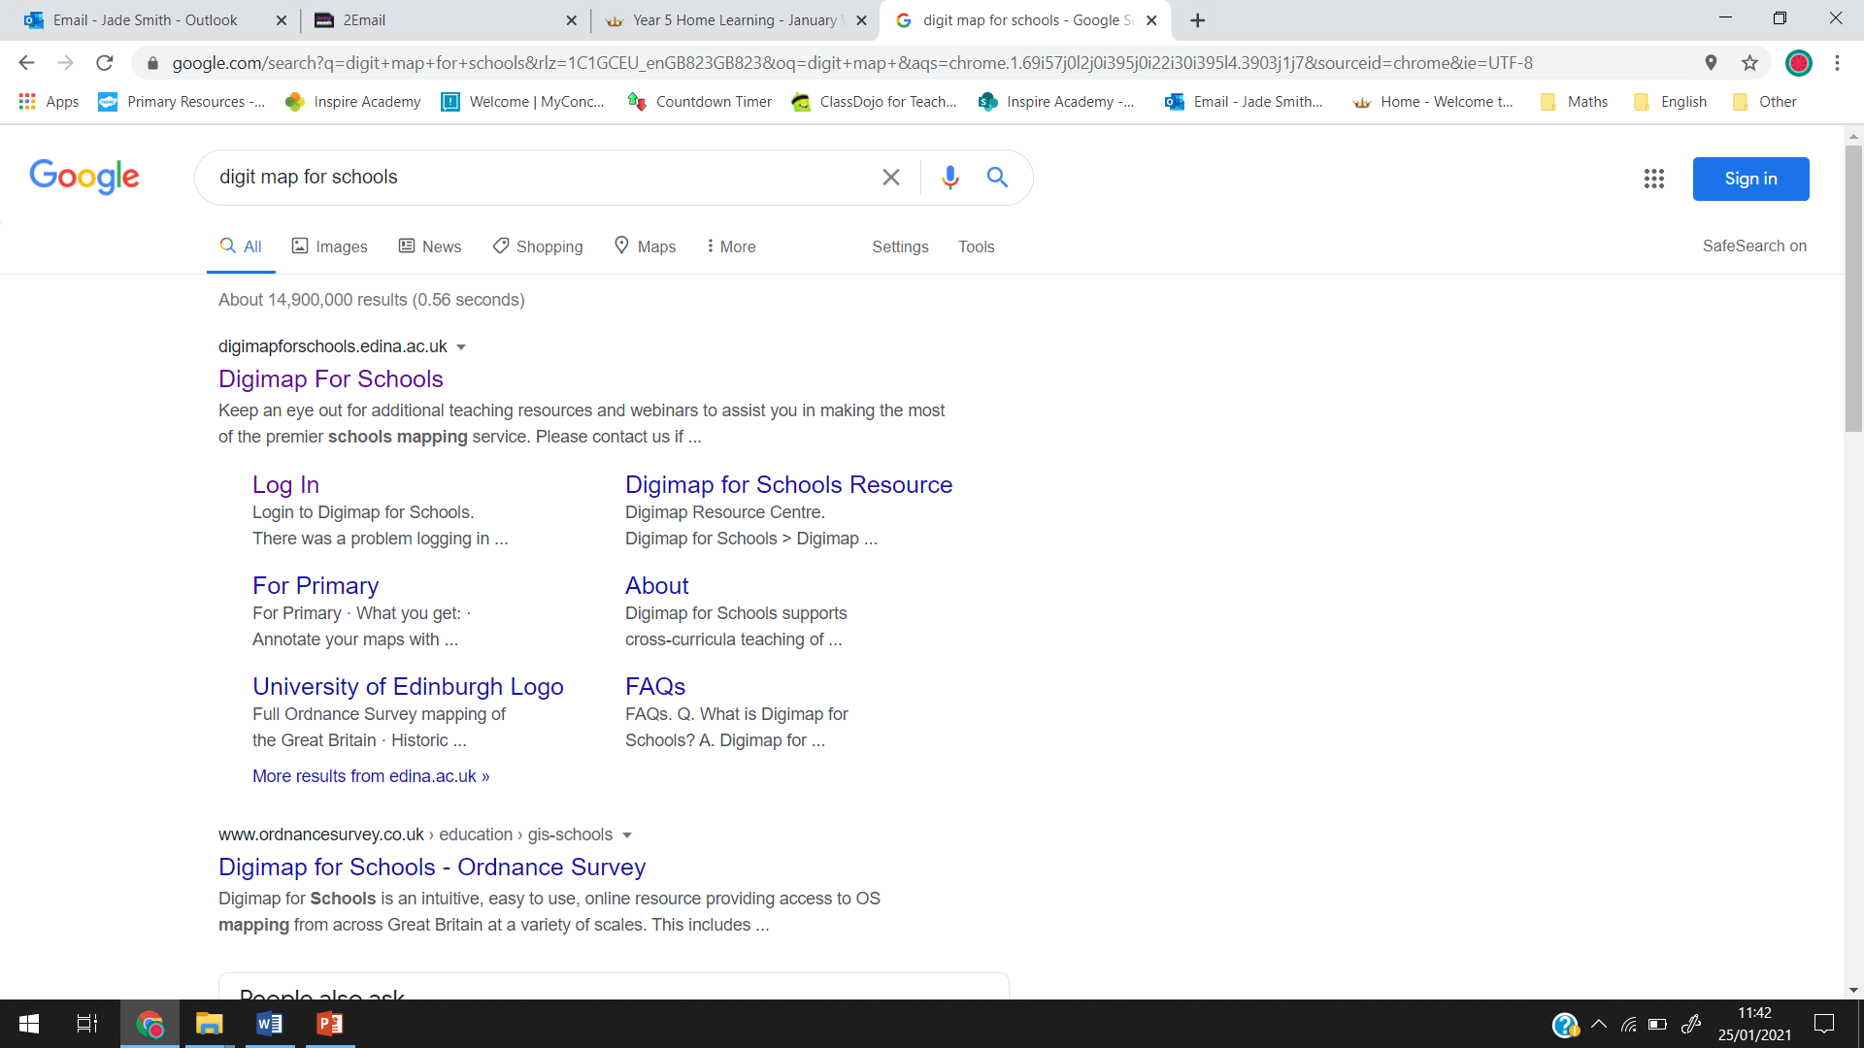
Select

Slide 25
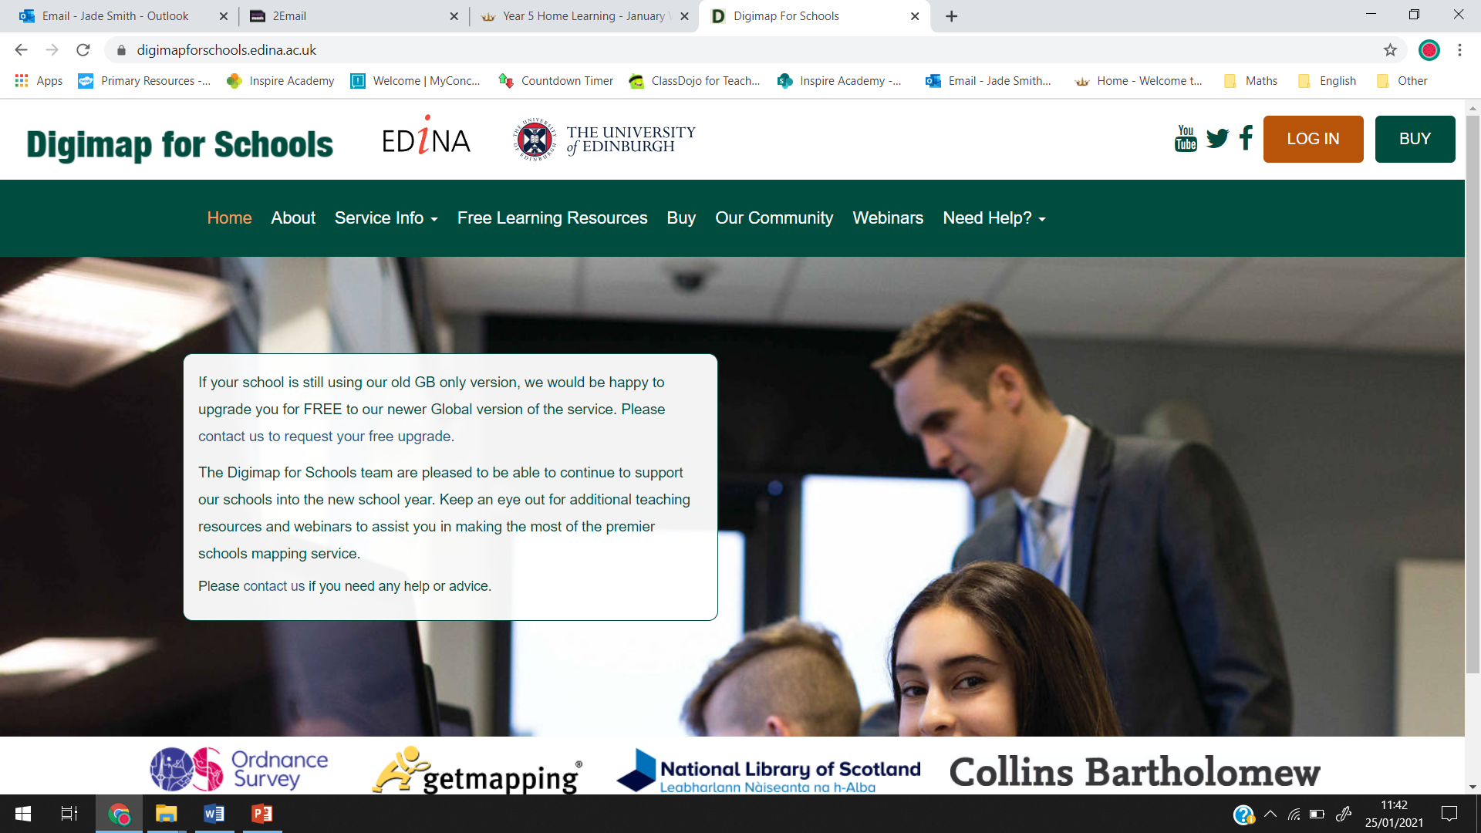
Username-
Password –
Check your purple mash emails to find out the username and password

Slide 26
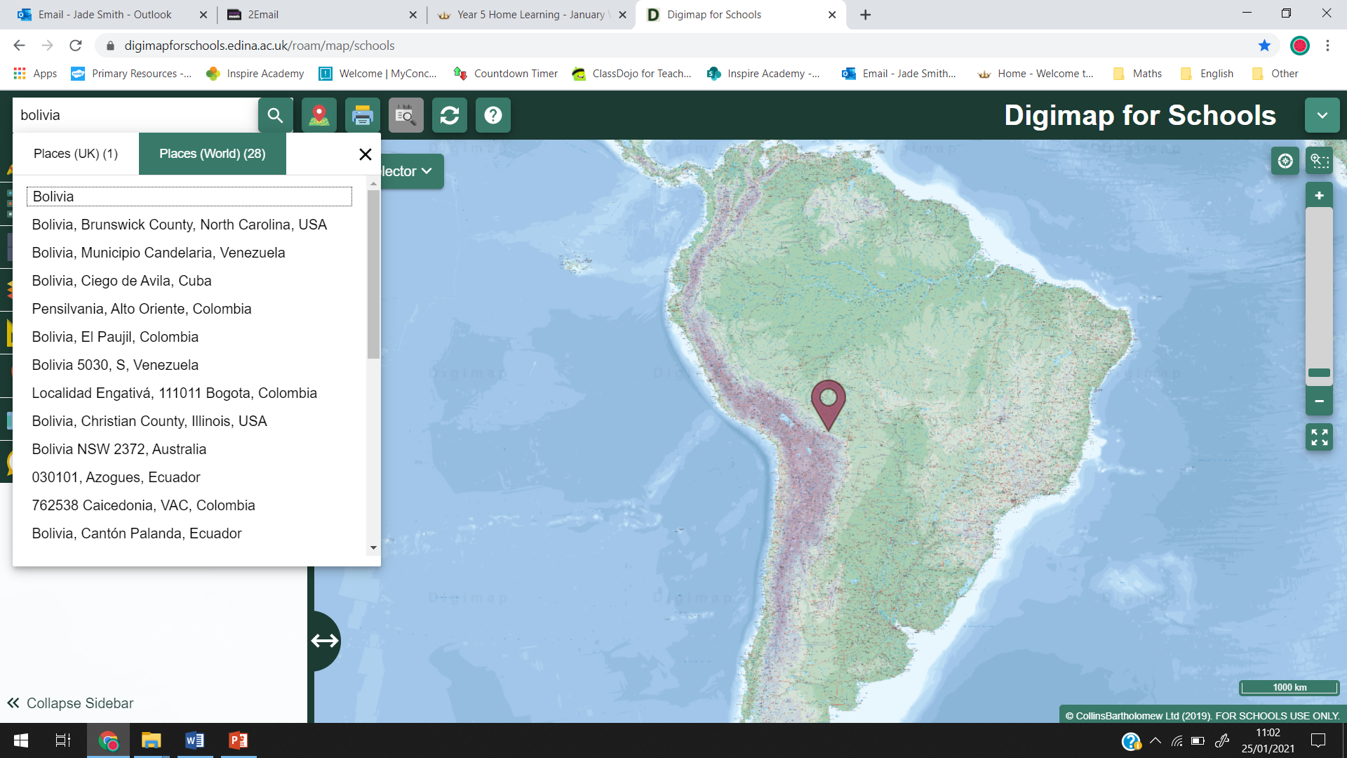
Type in Bolivia.
Select ‘ Places (World)

Slide 27
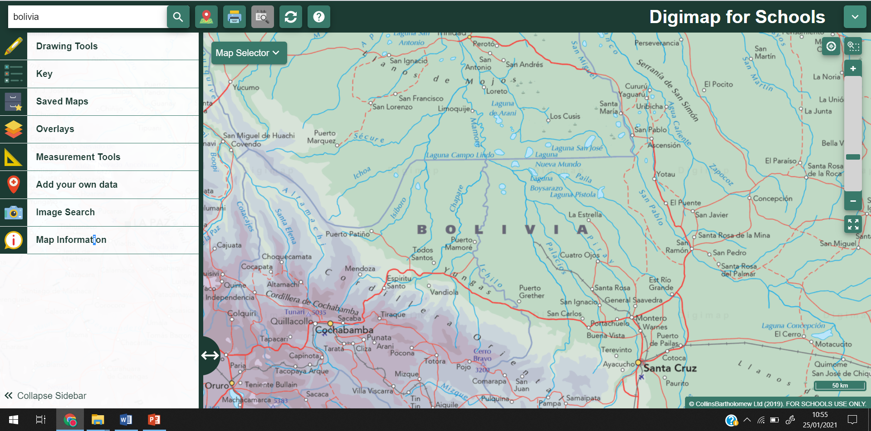
Zoom in to get a closer image of Bolivia. Don’t zoom in too much or the map will go white!

Slide 28
If this box is still here, press the X

Slide 29
If you want to add photographs to your map, you will need to save some from google.
Google- Type in ‘Brazil nut’ or ‘Brazil nut tree’
Select- ‘images’
Right click on any images that you like and select ‘save image as’
You need to save your images in a folder that you will be able to find them in later.
You could save them in the ‘picture’ folder (if you have one on your laptop)
You do not need to have pictures on if you are finding it difficult to do!

Slide 30
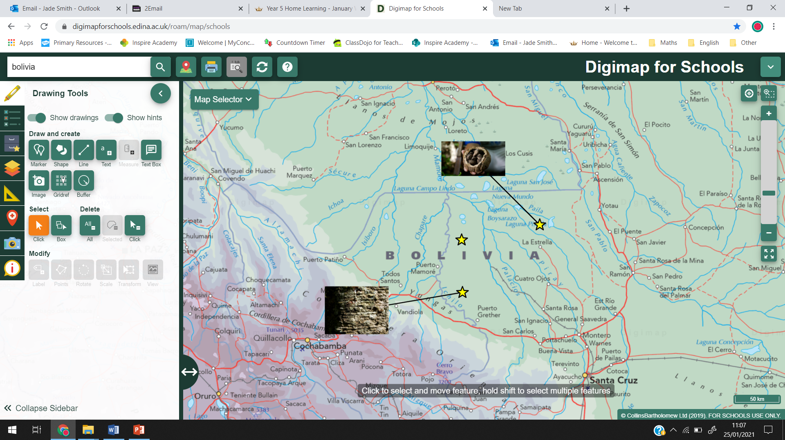
Select- Drawing tool.
Select- Image and click on your map, where you would like your photo to go.
Choose file- find the file that you have saved your pictures in.
Choose the picture you would like.
Complete again to add more pictures.

Slide 31
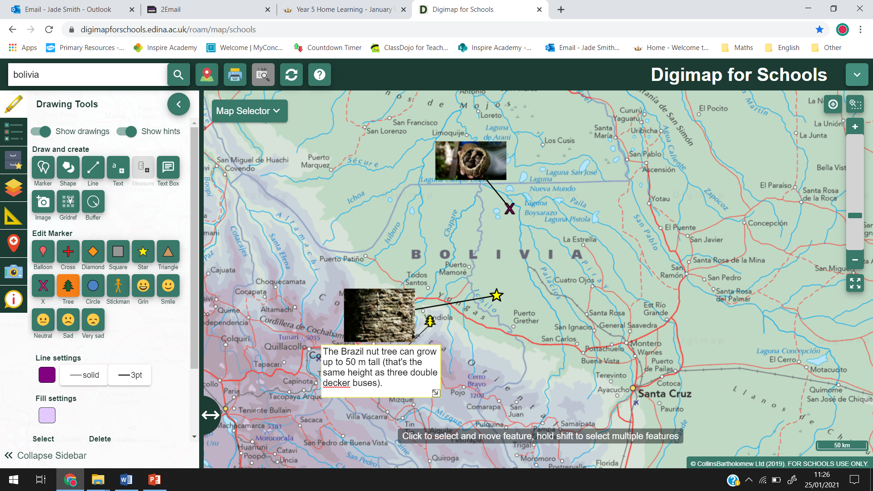
Select- Drawing tool.
Select- Text box and click on your map, where you would like it to go.
Click on the text box and type in your fact.
Complete again to add more text.

Slide 32
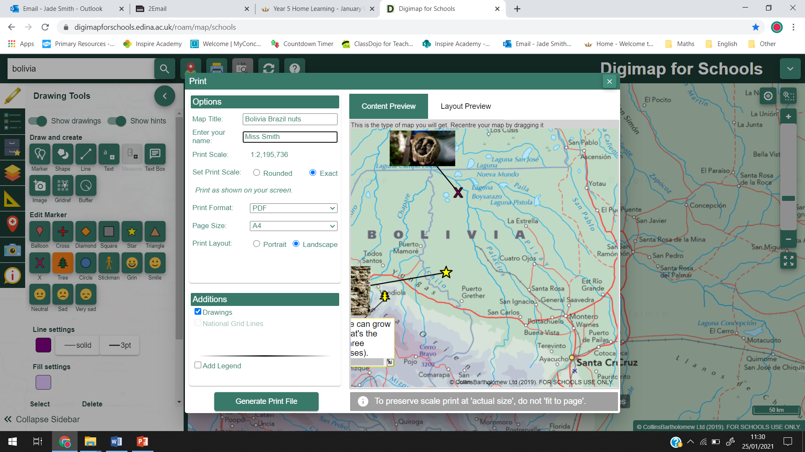
Once you have finished, select the printer icon.
Fill in the information
Select- Generate Print file
Save it on your laptop (make sure you know where you have saved it)

Slide 33
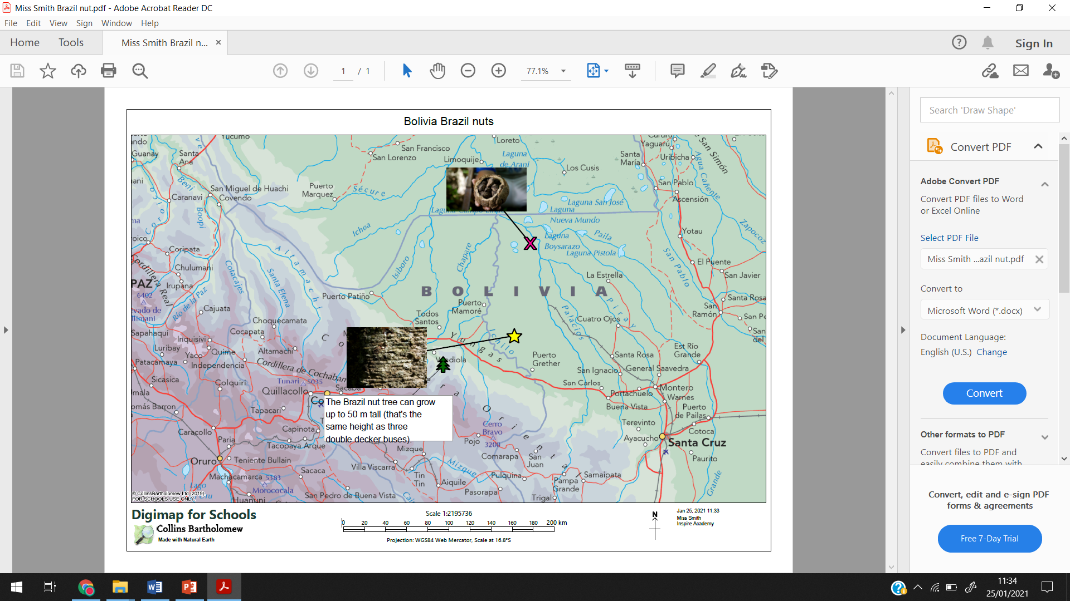
It should look like this in the saved area.
Now you can email it to your teachers ☺

