Slide 1
Gestation period
What does this mean?

Slide 2

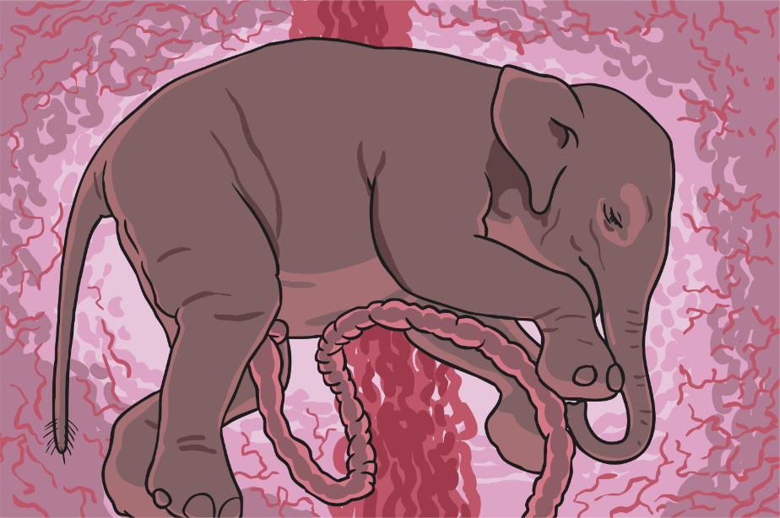
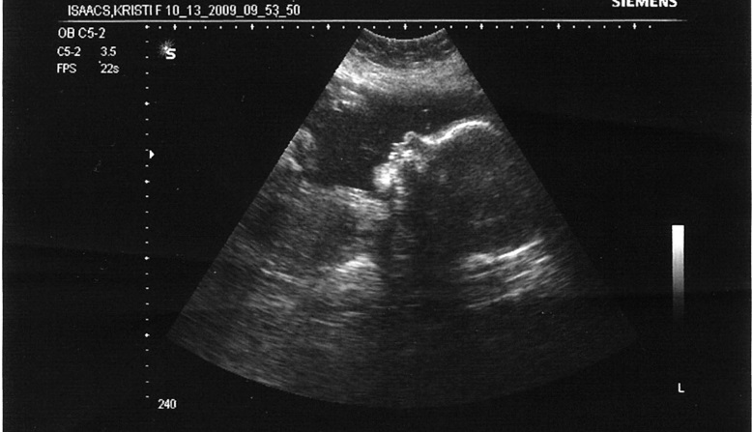
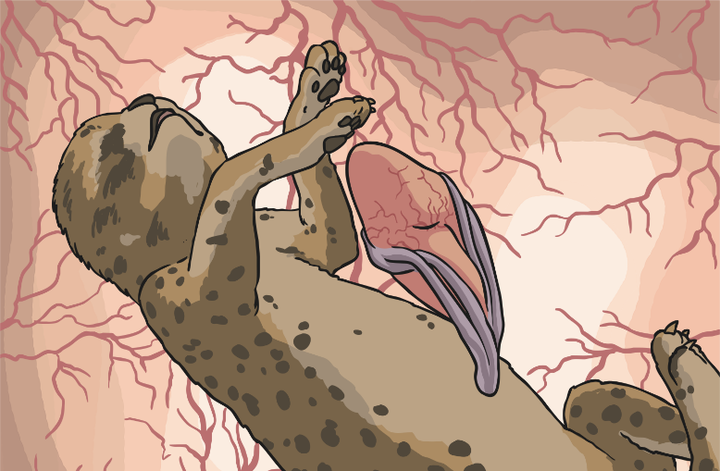
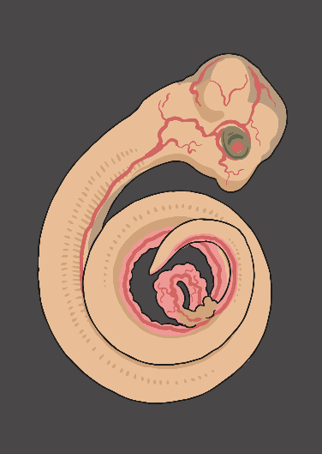
Gestation
What do you think gestation is?
Photo courtesy of Travis Isaacs (@flickr.com) -granted under creative commons licence – attribution

Slide 3
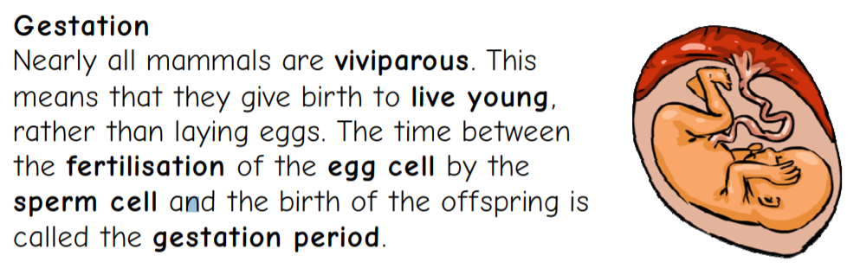
Gestation period

Slide 4
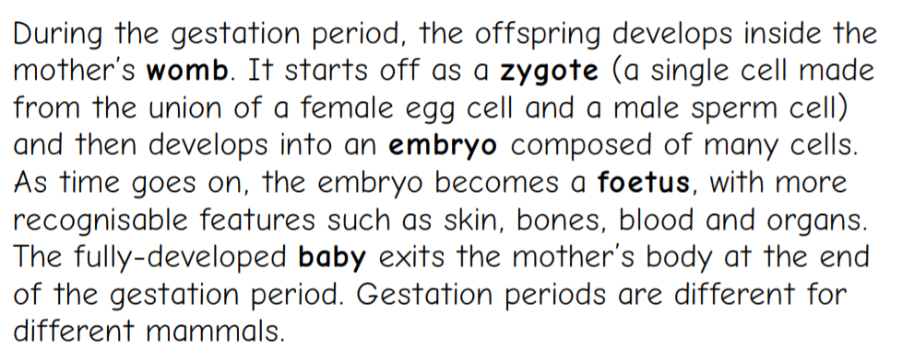

Slide 5
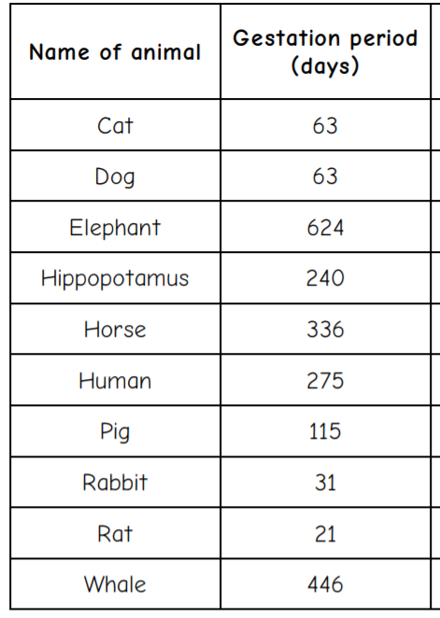
Using the information about each animals gestation period, create a bar chart on purple mash to show this information.
This will be set as a ‘2do’ for you.
Challenge- you could research different animals gestation period and use them to create a different bar chart or add them as extra to your bar chart.
You could research animals from the Amazon Rainforest.

Slide 6
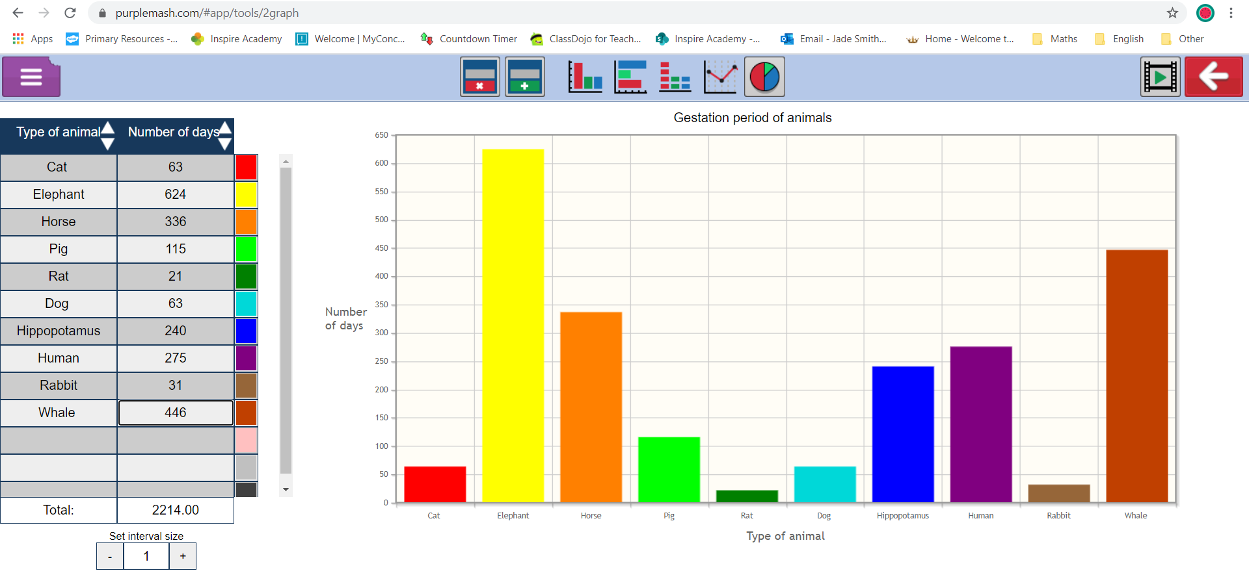
You can change your X and Y axis labels by changing it here.
Don’t forget to change your title too!

Slide 7
It should look something like this…

Slide 8
It should look something like this…
Don’t forget to save your work!

Slide 9
Using the data you have collected, do you notice any patterns?
Think about links between…
The size of the animal
If the animal lives on land or in the water
The colour of the animal
How many legs the animal has
Does any of these things make a difference to the length of the gestation period?
Are there any anomalies in our theory?
Write down any patterns that you notice.

