Slide 1

RE
Sikhism
We are learning to understand the relevance of Sikh stories today.

Slide 2
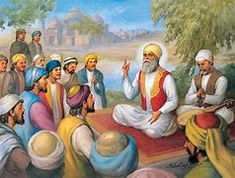
Bhai Lalo and Malik Bhago
Guru Nanak spent much of his time travelling around, visiting villages and towns so that he could teach people about God. He met many different kinds of people, rich and poor, honest and dishonest, humble and self-important. He talked to them all.

Slide 3
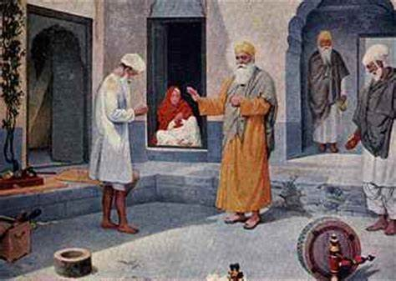
Nearing one village, Nanak felt tired and hungry so he decided to stay for a few days. Lalo, a poor carpenter, invited Nanak to stay at his house and Nanak was pleased to accept. Now it just so happens that a rich man named Malik Bhago who lived in the same village heard that the Guru was visiting and he sent his servants to invite Nanak to stay with him instead. He believed that Nanak would rather stay with him than in a poor man’s home. ‘I will give an enormous feast for all the important people in the village, and Nanak, as my guest of honour, can sit by my side’.

Slide 4
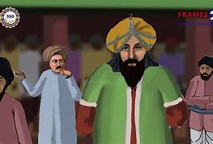
Many people came to Malik Bhago’s feast, but Nanak did not arrive. This made Malik Bhago very angry and he sent his servants to find Nanak. They went straight to Lalo’s house where they found Nanak. He agreed to go with them and arrived at Malik Bhago’s home to find a large crowd had gathered. They sensed that something was wrong, and wanted to see what would happen.

Slide 5
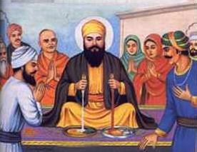
Malik Bhago met Nanak at the door. ‘Why did you refuse to come to my feast?’ Malik Bhago asked. ‘I had cakes and rich food for you to eat but your preferred to eat course bread’. Guru Nanak asked for a piece of cake. Then he took a piece of Lalo’s coarse bread from his bag. He squeezed them both. To the surprise of the crowd, drops of milk trickled from the bread, while from the cake came drops of blood. Malik Bhago shouted, ‘This is a trick!’

Slide 6
But Guru Nanak answered, ‘This is no trick. Lalo’s simple bread was earned by honest work, but your cake, and all your wealth, was gained by cheating the poor’.
Malik Bhago thought about what Guru Nanak had said and he felt ashamed of the way that he had lived. From then on, he changed his ways and followed the teachings of Guru Nanak.

Slide 7
Themes in this story are equality and honesty.
Are these important in today’s world?
Where is there inequality? What can be done about it?
Think about gender, disability, race, money, religion

