Slide 1
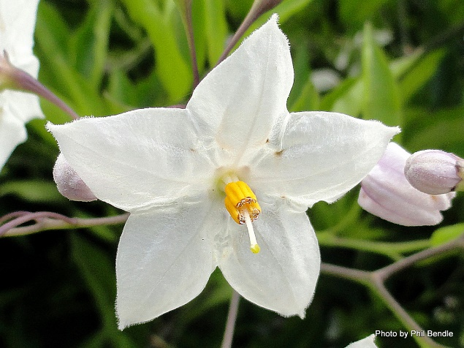
The Milk and the Jasmine Flower
Once upon a time the holy man, Guru Nanak was travelling in India under the hot sun with his
companion Mardana when they came close to a city. The holy men in the city heard about him
coming and were really frightened as they had been greedy and unkind, and they knew that he was
good man and they had promised to try to be good like him. They were afraid to let him into the city
so decided to send a messenger with a bowl full of milk to say that there was no room for anyone
else in the city: the city was as full as the bowl, and they were sorry that he could not come in.
Guru Nanak thanked the messenger and very gently picked a flower from a nearby bush and floated
it on the top of the milk saying that there would always be room in the world for more goodness.
The flower floated on top of the milk and not a drop was spilt: there was room for it! The messenger
returned to the city and told the holy men what had happened – they were filled with remorse and
sent the messenger back to welcome them to the city. The holy people apologised and gave the men
a warm welcome.
Guru Nanak believed that everyone is equal whether they are rich or poor.

