Slide 1
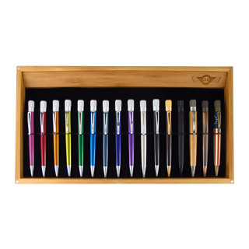
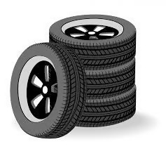
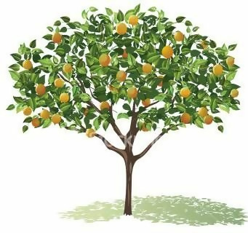
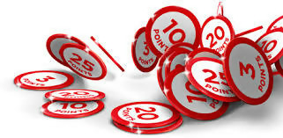
5
Solve the word problems. Show your working out.
1
2
There are 12 bookshelves
with 1132 books on
each shelf.
How many books are in total
on all bookshelves?
A store sells boxes
with pens.
Each box contains 16 pens.
How many pens are in
2011 boxes?
x =
x =
3
4
The theatre ticket price
is £14.
How much will the theatre
earn on selling
3142 tickets?
A tyre factory produces
5328 tyres a day.
How many tyres will the
factory produce in 37 days?
x =
x =
5
6
The area of a tangerine garden measures 26 acres.
One acre has
1354 tangerine trees.
How many tangerine trees are
in the garden?
In each turn in a game you
can get 78 points maximum.
The game consists of
2819 turns.
What is the maximal number of points you can get in the game?
x =
x =
7
8
A sports company sells
9872 balls each month.
How many balls does
the company sell in a year?
A pizzeria makes 3625 pizzas
each week.
How many pizzas does
the shop make in 12 weeks?
x =
x =

Slide 2
Multiply 4-digits by 2-digits
Answers
5
Solve the word problems. Show your working out.
1
2
There are 12 bookshelves
with 1132 books on
each shelf.
How many books are in total
on all bookshelves?
A store sells boxes
with pens.
Each box contains 16 pens.
How many pens are in
2011 boxes?
12
13584
2011
16
32176
1132
x =
x =
3
4
The theatre ticket price
is £14.
How much will the theatre
earn on selling
3142 tickets?
A tyre factory produces
5328 tyres a day.
How many tyres will the
factory produce in 37 days?
14
43988
5328
x =
197136
3142
x =
37
5
6
The area of a tangerine garden measures 26 acres.
One acre has
1354 tangerine trees.
How many tangerine trees are
in the garden?
In each turn in a game you
can get 78 points maximum.
The game consists of
2819 turns.
What is the maximal number of points you can get in the game?
1354
x =
35204
2819
78
219882
26
x =
7
8
A sports company sells
9872 balls each month.
How many balls does
the company sell in a year?
A pizzeria makes 3625 pizzas
each week.
How many pizzas does
the shop make in 12 weeks?
3625
12
9872
12
118464
x =
43500
x =

Slide 3
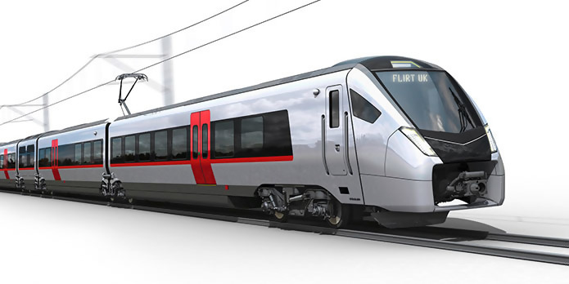
Multiply 4-digits by 2-digits
5
Solve the word problems. Show your working out.
1
2
There are 37 bookcases
in the library.
Each bookcase has 44 rows
with 65 books in the row.
How many books are in total
in the library?
A store sells boxes
with pens.
Each box has 4 parts with
16 pens in each part.
How many pens are in
1888 boxes?
3
4
A tyre factory produces
4328 tyres a day.
How many tyres will the
factory produce in 4 weeks?
A train is moving with
the speed of 32 m/s.
What is the distance
the train moves
in 26 minutes?
5
6
A tangerine garden is
38 metres by 56 metres .
One square metre gives
on average 69 tangerines.
How many tangerines
are on average in the garden?
In each turn in a game you
can get at most 27 bonuses.
Each bonus is worth 3 points.
The game consists of
1515 turns.
What is the maximal number of points you can get in the game?
7
8
A sports company sells
on average 1859 balls weekly.
How many balls does
the company sell
on average in a year?
A pizzeria makes 2324 pizzas
each week.
The price of the pizza is £13.
How much will the shop
make in 3 weeks?

Slide 4
Multiply 4-digits by 2-digits
Answers
5
Solve the word problems. Show your working out.
1
2
There are 37 bookcases
in the library.
Each bookcase has 44 rows
with 65 books in the row.
How many books are in total
in the library?
A store sells boxes
with pens.
Each box has 4 parts with
16 pens in each part.
How many pens are in
1888 boxes?
105820
37$⋅$44=1628 rows
1628$⋅$65=105820 books
120832
16$⋅$4=64 pens in box
1888$⋅$64=120832 books
3
4
A tyre factory produces
4328 tyres a day.
How many tyres will the
factory produce in 4 weeks?
A train is moving with
the speed of 32 m/s.
What is the distance
the train moves
in 26 minutes?
26$⋅$60=1560 seconds
1560$⋅$32=49920 distance
49920
4$⋅$7=28 days
4328$⋅$28=121184 produce
121184
5
6
A tangerine garden is
38 metres by 56 metres .
One square metre gives
on average 69 tangerines.
How many tangerines
are on average in the garden?
In each turn in a game you
can get at most 27 bonuses.
Each bonus is worth 3 points.
The game consists of
1515 turns.
What is the maximal number of points you can get in the game?
146832
38$⋅$56=2128 area
2128$⋅$69=146832 tangerines
122715
27$⋅$3=81 points
1515$⋅$81=122715 maximal number of points
7
8
A sports company sells
on average 1859 balls weekly.
How many balls does
the company sell
on average in a year?
A pizzeria makes 2324 pizzas
each week.
The price of the pizza is £13.
How much will the shop
make in 3 weeks?
2324$⋅$3=6972
make pizzas in 3 weeks
6972$⋅$£13=90636
earn in 3 weeks
90636
There are 52 weeks in a year,
1859$⋅$52=96668 balls
96668

Slide 5
Multiply 3-digits by 2-digits
5
Solve the word problems. Show your working out.
1
2
The theatre ticket price is £14 for adults
and £11 for children.
How much will the theatre earn on selling 1145 tickets for adults and 2238 tickets for children?
A train is moving 34 minutes
with the speed of 32 m/s and 45 minutes
with the speed of 28m/s.
What is the distance the train moves in total?
3
4
A pizzaiolo can make 2228 large pizzas or
3872 small pizzas each week.
The price of large pizza is £18 and the price
of small pizza is £12.
A tyre factory produces 4132 tyres a day and sells them for £13 per tyre.
How much will the factory earn on selling all
What pizza is more profitable for the pizzaiola to make?
tyres produced in 1 week?
5
6
Pamela can run 15 miles
in 1 hour 22 minutes.
How long in seconds will it take her to run
165 miles?
27 rabbits = 1 sheep
14 sheep = 1 pig
10 pigs = 1 cow
2 cows = 1 horse
How many rabbits will 11 horses equal?
7

Slide 6
Multiply 3-digits by 2-digits
Answers
5
Solve the word problems. Show your working out.
1
2
The theatre ticket price is £14 for adults
and £11 for children.
How much will the theatre earn on selling 1145 tickets for adults and 2238 tickets for children?
A train is moving 34 minutes
with the speed of 32 m/s and 45 minutes
with the speed of 28 m/s.
What is the distance the train moves in total?
34$⋅$60=2040 with speed 32 m/s
45$⋅$60=2700 with speed 28 m/s
2040$⋅$32=65280 m
2700$⋅$28=75600 m
65280$+$75600=140880 m
1145$⋅$ £14=£16030 tickets for adults
2238$⋅$ £11=£24618 tickets for children
£16030$+\text{£}\text{24618}\text{=£}\text{40648}$
all tickets
40648
140880
3
4
A pizzaiolo can make 2228 large pizzas or
3872 small pizzas each week.
The price of large pizza is £18 and the price
of small pizza is £12.
A tyre factory produces 4132 tyres a day and sells them for £13 per tyre.
How much will the factory earn on selling all
What pizza is more profitable for the pizzaiola to make?
tyres produced in 1 week?
2228$⋅$ £18= £40104
large pizza
3872$⋅$ £12= £46464
small pizza
4132$⋅$ £13= £53716 will earn in one day
£53716$⋅$7 = £376012 will earn on selling all tires
small pizzas
376012
5
6
Pamela can run 15 miles
in 1 hour 22 minutes.
How long in seconds will it take her to run
165 miles?
27 rabbits = 1 sheep
14 sheep = 1 pig
10 pigs = 1 cow
2 cows = 1 horse
How many rabbits will 11 horses equal?
1 hour = 60 minutes, 1 hour 22 minutes = 82 minutes, 82$⋅$60=4920 seconds,
1 hour 22 minutes = 4920 seconds
165$÷$15=11
4920$⋅$11=54120 miles
11 horses = 22 cows
22 cows = 220 pigs
220 pigs = 3080 sheep
3080 sheep = 83160 rabbits
54120
83160
7

