Slide 1

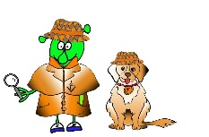

French Y4 Stage 2 Spring 1: Family
Language Detectives’ Memory Bank of Family
Noun Bank
Le papa -the dad
Le frère – the brother
Le bébé – the baby
Le grand- père – the grandad
La maman - the mum
La soeur – the sister
La grand-mère- the grandma
La famille– the family
Sound spelling
“uis”
“ille”
“é”
Grammar
There are two words for “the” in French with singular nouns.
These words are “le” and “la”
Question and Answer Bank
Qui es- tu? – Who are you?
Je suis ….. – I am …..

