Slide 1
Unit 5.2: We are cryptographers
Cracking codes

Slide 2
Unit learning objectives
In this unit, you will learn:
about using semaphore and Morse code
to understand the need for private information to be encrypted
to encrypt and decrypt messages in simple ciphers
about the need to use complex passwords and to keep them secure
about how encryption works on the Internet.
Do you know what the bold words mean?
Click on this box to see the definitions.

Slide 3

Key Vocabulary
Semaphore: a simple code for converting letters and numbers into different positions of two flags, one held in each hand
Morse code: a simple code for converting letters and numbers into patterns of short and long electrical pulses
Encrypt: to convert a readable message into an encrypted form so that it cannot be read by those without a key
Decrypt: to convert an encrypted message into readable text
Message: information to be transmitted from one person (or system) to another
Cipher: an agreed scheme (algorithm) for encrypting or decrypting a message

Slide 4
Session 1: Transmitting information in semaphore
To communicate information using semaphore

Slide 5
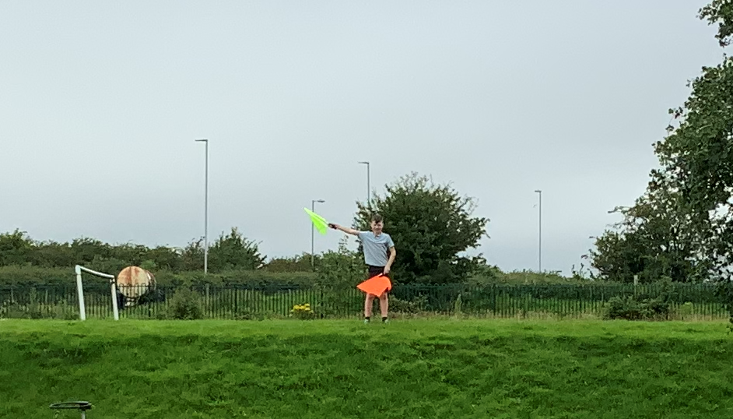
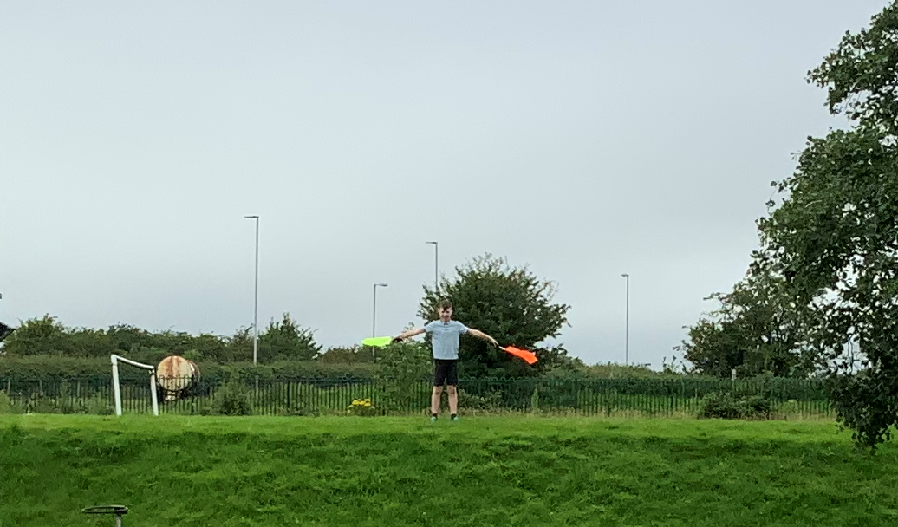
Let’s learn
In this session you will learn about semaphore and how it transmits information. You will communicate information over short and long distances.
Semaphore: a simple code for converting letters and numbers into different positions of two flags, one held in each hand
Do you know what semaphore is?
Click on this box to see the definition.
Do you know what transmit means?
Click on this box to see the definition.
Transmit: to communicate a message over a long distance

Slide 6
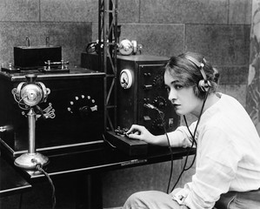
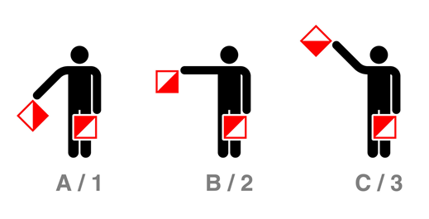

Let’s discuss
How do you think people communicated over long distances before the telephone or the Internet existed?
What if they wanted to communicate as quickly as possible?
Notes:
You could talk about posting letters, using telegraphs, or signal flags on ships.

Slide 7
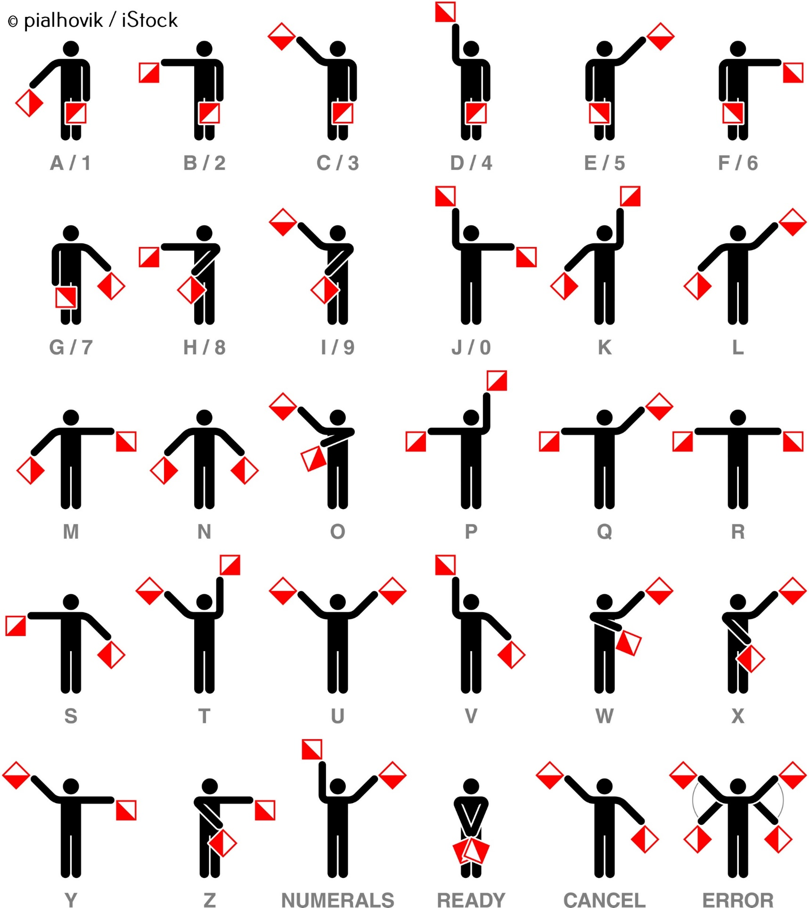
Let’s learn
This is the semaphore alphabet. Messages are communicated by breaking them down into individual letters and sending each letter over line-of-sight distances using a simple flag code.
Let’s do
You have a semaphore reference sheet and flags.
In pairs, use the sheet to practise sending and receiving messages between you.

Slide 8
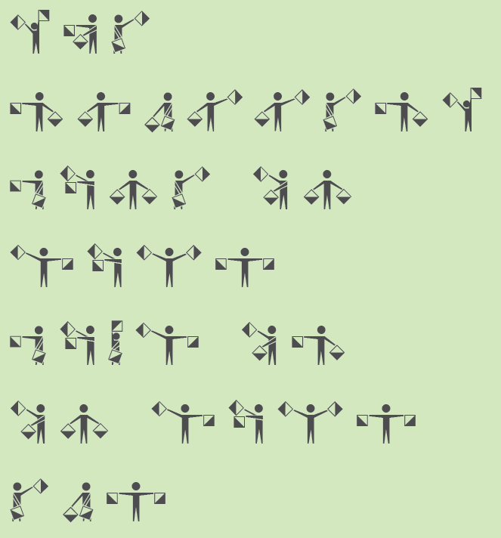
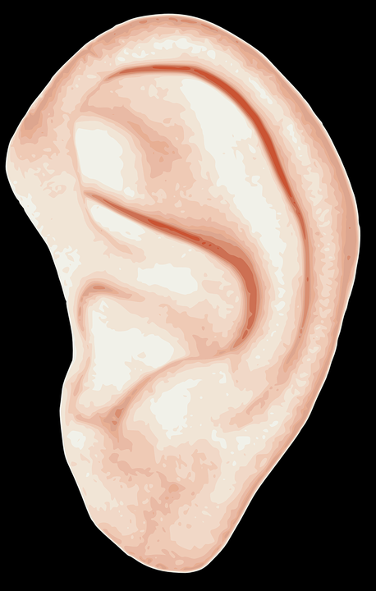
Let’s do
Can you work in pairs to decode this semaphore message? What does it say?
Answer on the next slide!

Slide 9
THE
SMALLEST
BONE IN
YOUR
BODY IS
IN YOUR
EAR

Slide 10
Let’s discuss
How do you think you might use semaphore to communicate over longer distances where the communicators cannot see each other?
Let’s do
Imagine a sequence of semaphore signallers copying down messages and then passing them onto the next person in a chain.
Try to send a message this way.
A pair can be in each position – one to send the message and one to receive the message.
Tip!
It is possible to pass the message on letter by letter, rather than waiting for the whole message.

Slide 11
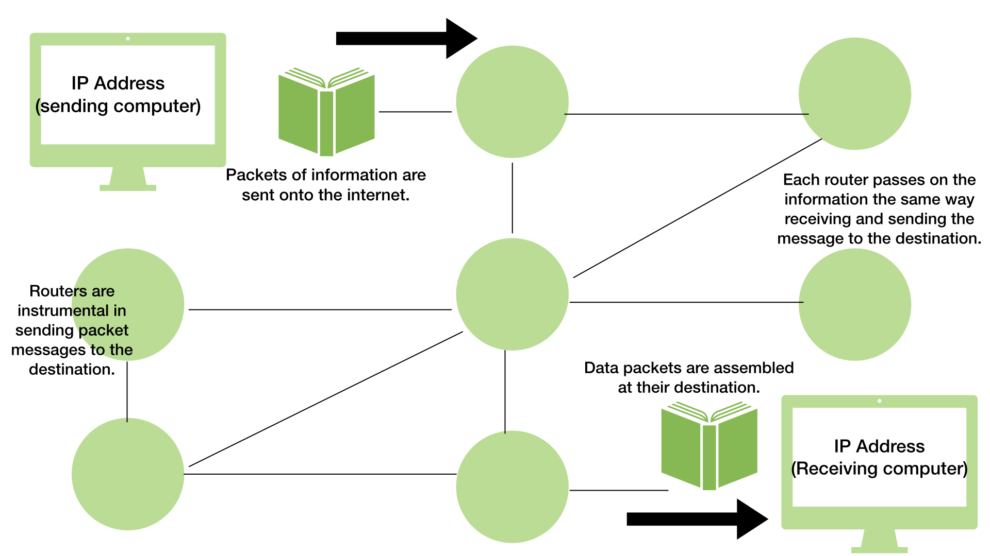
Let’s learn
The way messages are transmitted using semaphore is not unlike how Internet routers pass on data packets.

