Slide 1
Session 2: Using Morse code
To communicate messages using Morse code

Slide 2
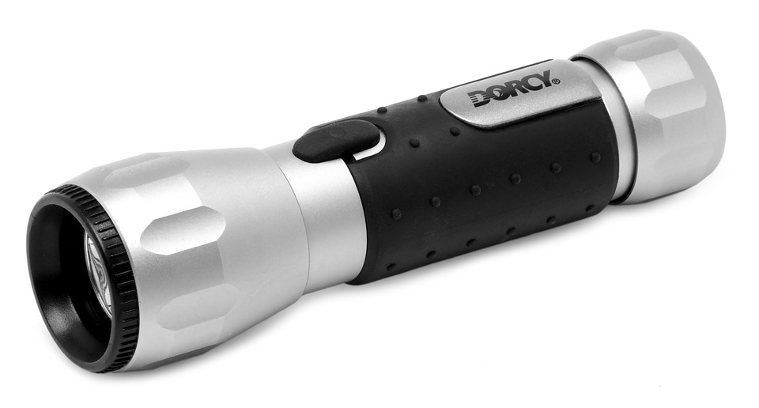
Let’s learn
In this session, you will investigate how Morse code works and communicate messages using Morse code with a torch. You will experiment with transmitting messages over short and longer distances and compare it to using semaphore.
Let’s think
Try to work out how you can use a torch to pass a message to your friend.
Let’s discuss
What solutions did you come up with?
Do you know what the words in bold mean?
Click here to see the definitions.

Slide 3
Key vocabulary
Codes: ways of changing the way information is represented
Morse code: a simple code for converting letters and numbers into patterns of short and long electrical pulses
Message: information to be transmitted from one person (or system) to another
Transmit: to communicate a message over a long distance
Semaphore: a simple code for converting letters and numbers into different positions of two flags, one held in each hand

Slide 4
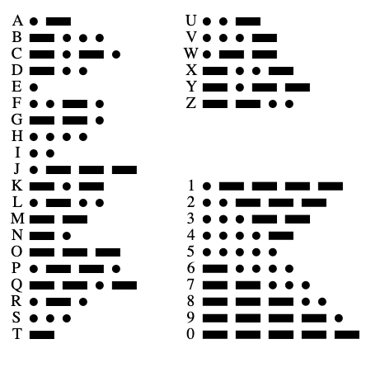
Let’s learn
Morse code is a binary code. A binary code is a code that uses only two symbols – in the case of Morse code on and off.
In Morse code, each letter is represented by a particular sequence of short or long pulses of light or sound, separated by gaps.

Slide 5
Let’s do
You have a Morse code reference sheet and a torch.
Practice sending and receiving messages using Morse code over line-of-sight distances using a torch.

Slide 6
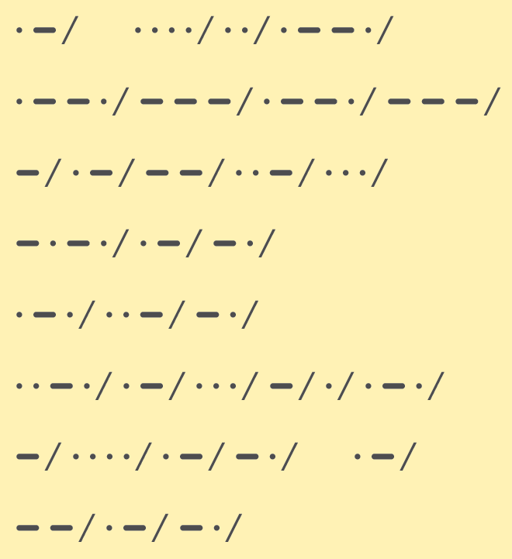
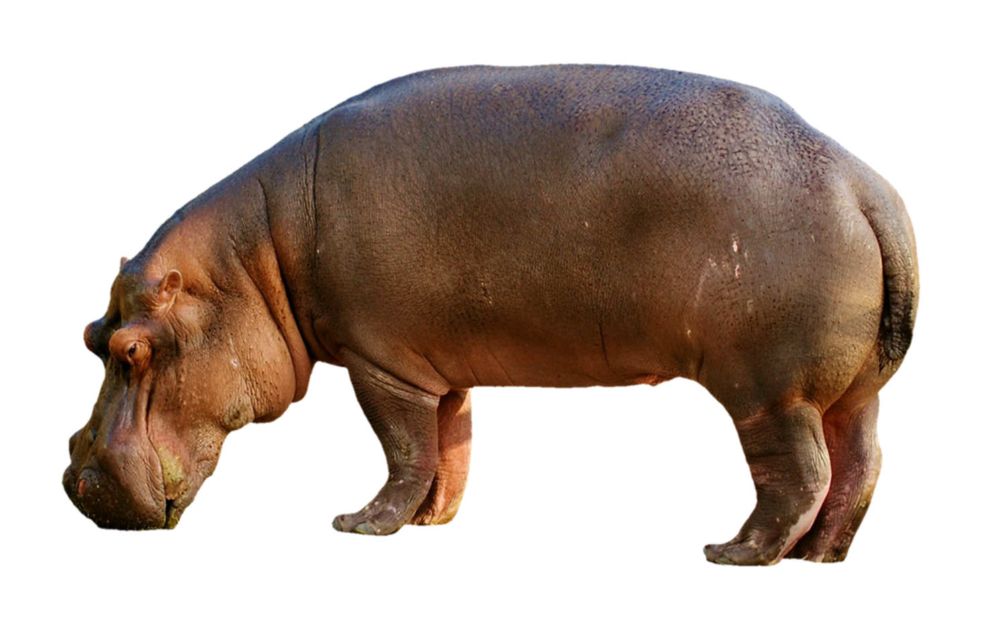
Let’s do
In pairs, can you decode this message? What does it say?
Answer on the next slide!

Slide 7
A
HIPPOPOTAMUS
CAN
RUN
FASTER
THAN A
MAN

Slide 8
Let’s discuss
Compare Morse code with semaphore. Which did you find easier to use and why?
Why do you think that some letters, such as E and T, have short codes, whereas others like Q, Y and Z have longer codes?
How might Morse code be used over longer distances?
Notes:
Some letters of the alphabet are much more common than others. Samuel Morse designed the code to be as efficient as possible by assigning the shortest codes to the most common letters.
In answer to question 3, pupils might suggest a similar receive and resend method as with semaphore. Ask them about other possibilities. Try and elicit the suggestion on the next slide.

Slide 9
Let’s learn
Morse code has some similarities with the Internet. Electrical on/off binary signals form the basis of communication at the hardware level, although the code is different from Morse’s and is represented by zeros and ones.
Binary works from switches being turned on or off, but it works in a similar way to Morse code, e.g. Hello = 01001000 01100101 01101100 01101100 01101111

Slide 10
Task- Can you send a message using Morse Code?
You could try to send it to someone you live with or record it and email it to us. We will try and guess what you are telling us.
Don’t worry if you haven’t got a torch, you could use the torch on your phone!

