Slide 1


Year 4 – Spring Block 3 – Fractions
Step 7: Subtract 2 Fractions
© Classroom Secrets Limited 2019

Slide 2
Introduction
Match the calculation to the representation.
A.
B.
C.
4 |  | + |  | 5
5 |  |  |  | 5
1.
2.
3.
5 |  | + |  | 3
4 |  |  |  | 4
8 |  | + |  | 3
6 |  |  |  | 6
© Classroom Secrets Limited 2019

Slide 3
Introduction
Match the calculation to the representation.
A. 3; B. 1; C. 2
A.
B.
C.
4 |  | + |  | 5
5 |  |  |  | 5
1.
2.
3.
5 |  | + |  | 3
4 |  |  |  | 4
8 |  | + |  | 3
6 |  |  |  | 6
© Classroom Secrets Limited 2019

Slide 4
Varied Fluency 1
Use the images below to help you calculate the subtraction.
7 | – | 4 | =
5 |  | 5
#
© Classroom Secrets Limited 2019

Slide 5
Varied Fluency 1
Use the images below to help you calculate the subtraction.
7 | – | 4 | =
5 |  | 5
3
#
5
© Classroom Secrets Limited 2019

Slide 6
Varied Fluency 2
Match the calculation to the correct answer.
12 | – | 6 | =
7 |  | 7
#
A. | 7
 | 7
B. | 1
 | 7
C. | 6
 | 7
© Classroom Secrets Limited 2019

Slide 7
Varied Fluency 2
Match the calculation to the correct answer.
12 | – | 6 | =
7 |  | 7
6
#
7
A. | 7
 | 7
B. | 1
 | 7
C. | 6
 | 7
© Classroom Secrets Limited 2019

Slide 8
Varied Fluency 3
Circle the calculation that matches the representation.
18 | – | 8
10 |  | 10
18 | – | 7
10 |  | 10
© Classroom Secrets Limited 2019

Slide 9
Varied Fluency 3
Circle the calculation that matches the representation.
18 | – | 8
10 |  | 10
18 | – | 7
10 |  | 10
© Classroom Secrets Limited 2019

Slide 10
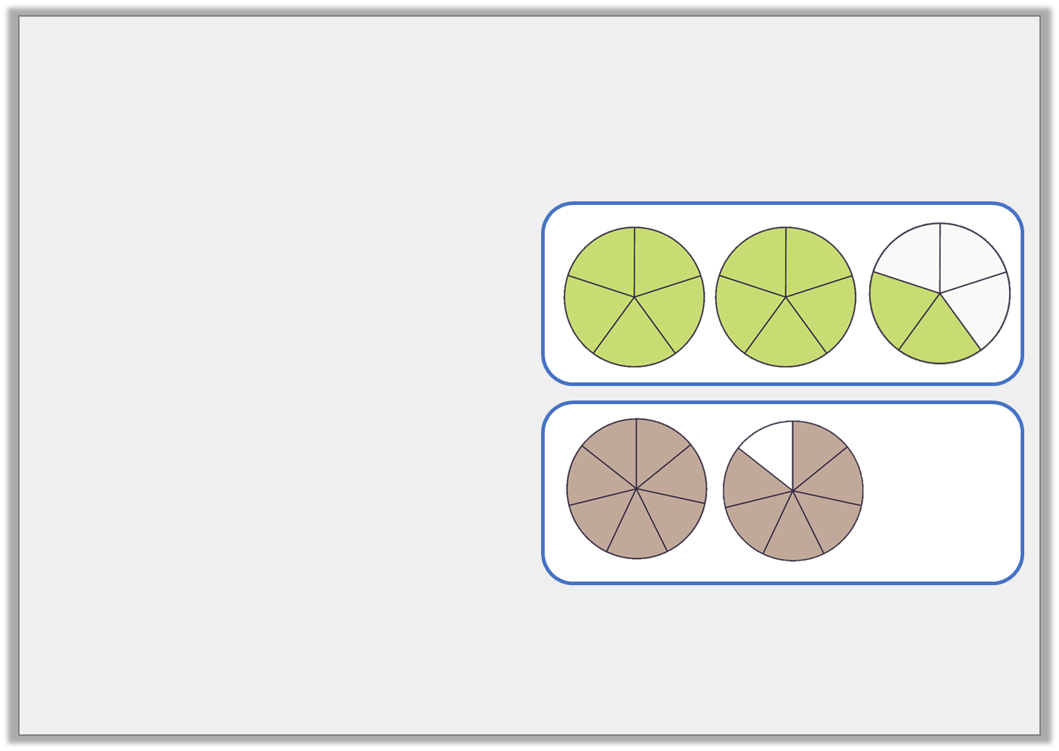
Varied Fluency 4
Complete the calculations.
A.
B.
12
5
= | 4
 | 5
–
13
7
= | 2
 | 7
–
© Classroom Secrets Limited 2019

Slide 11
Varied Fluency 4
Complete the calculations.
A.
B.
12
5
8
5
= | 4
 | 5
–
13
7
11
7
= | 2
 | 7
–
© Classroom Secrets Limited 2019

Slide 12

Reasoning 1
Anika’s ribbon measures metres.
Simon’s ribbon measures less than Anika’s.
Is she correct? Explain your answer.
8
6
4
6
Simon’s ribbon is
of a metre.
3
6
Anika
© Classroom Secrets Limited 2019

Slide 13
Reasoning 1
Anika’s ribbon measures metres.
Simon’s ribbon measures less than Anika’s.
Is she correct? Explain your answer.
No, Anika is incorrect because…
8
6
4
6
Simon’s ribbon is
of a metre.
3
6
Anika
© Classroom Secrets Limited 2019

Slide 14
Reasoning 1
Anika’s ribbon measures metres.
Simon’s ribbon measures less than Anika’s.
Is she correct? Explain your answer.
No, Anika is incorrect because .
8
6
4
6
Simon’s ribbon is
of a metre.
3
6
Anika
8 | – | 4 | = | 4
6 |  | 6 |  | 6
© Classroom Secrets Limited 2019

Slide 15
Problem Solving 1
Use the digit cards to complete this calculation. You can use each card more than once if you wish.
6 |  | 8 |  | 10 |  | 4
16 | – |  | =
© Classroom Secrets Limited 2019

Slide 16
Problem Solving 1
Use the digit cards to complete this calculation. You can use each card more than once if you wish.
Various answers, one example is shown above.
6 |  | 8 |  | 10 |  | 4
16 | – | 8 | = | 8
10 |  | 10 |  | 10
© Classroom Secrets Limited 2019

Slide 17
Reasoning 2
Are these calculations the same?
Use the shapes to prove your answer.
14 | – | 7
8 |  | 8
14 | – | 5 | – | 3
8 |  | 8 |  | 8
© Classroom Secrets Limited 2019

Slide 18
Reasoning 2
Are these calculations the same?
Use the shapes to prove your answer. The calculations are not the same because…
14 | – | 7
8 |  | 8
14 | – | 5 | – | 3
8 |  | 8 |  | 8
© Classroom Secrets Limited 2019

Slide 19
Reasoning 2
Are these calculations the same?
Use the shapes to prove your answer.
The calculations are not the same because:
but .
14 | – | 7
8 |  | 8
14 | – | 5 | – | 3
8 |  | 8 |  | 8
14 | – | 7 | = | 7
8 |  | 8 |  | 8
14 | – | 5 | – | 3 | = | 6
8 |  | 8 |  | 8 |  | 8
© Classroom Secrets Limited 2019

