Slide 1


Year 4 – Spring Block 3 – Fractions
Step 6: Add 2 or More Fractions
© Classroom Secrets Limited 2019

Slide 2
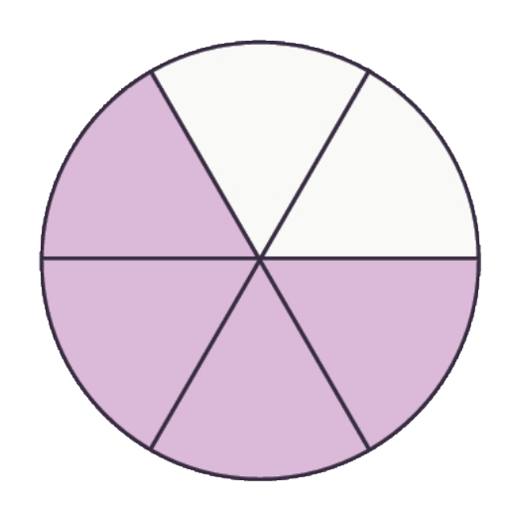
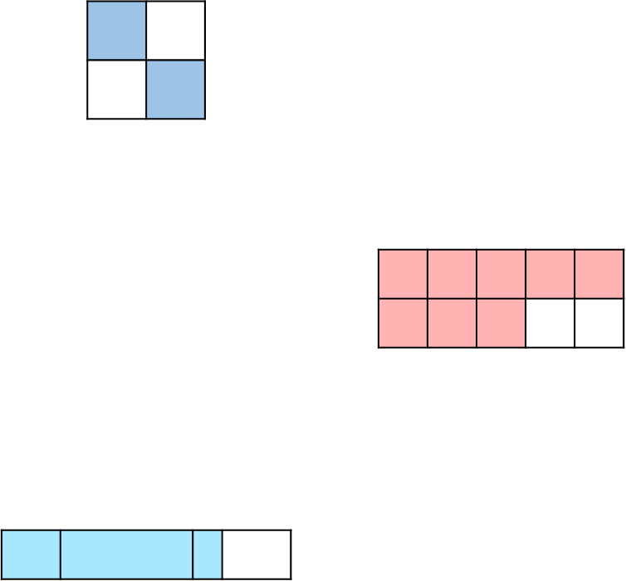

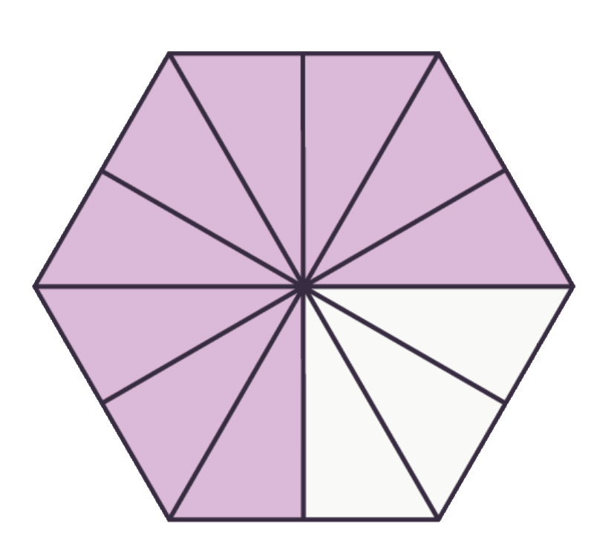
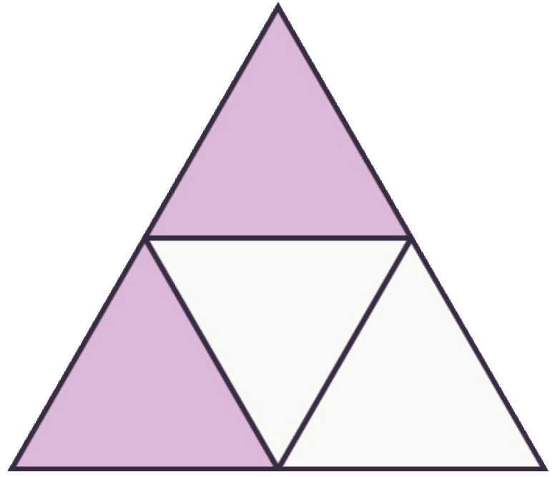
Introduction
Circle the shapes below that are equivalent to .
3
4
© Classroom Secrets Limited 2019

Slide 3
Introduction
Circle the shapes below that are equivalent to .
3
4
© Classroom Secrets Limited 2019

Slide 4
Varied Fluency 1
Shade the model to complete the following calculation.
4 | + | 9 | =
10 |  | 10
© Classroom Secrets Limited 2019

Slide 5
Varied Fluency 1
Shade the model to complete the following calculation.
4 | + | 9 | = | 13
10 |  | 10 |  | 10
© Classroom Secrets Limited 2019

Slide 6
Varied Fluency 2
Complete the calculation below.
7 | + | 4 | + | 5 | =
9 |  | 9 |  | 9
© Classroom Secrets Limited 2019

Slide 7
Varied Fluency 2
Complete the calculation below.
7 | + | 4 | + | 5 | = | 16
9 |  | 9 |  | 9 |  | 9
© Classroom Secrets Limited 2019

Slide 8
Varied Fluency 3
Tick the correct answer. Use the empty number line to help you.
5 | + | 11 | + | 4 | =
7 |  | 7 |  | 7
20
21
18
7
20
7
© Classroom Secrets Limited 2019

Slide 9
Varied Fluency 3
Tick the correct answer. Use the empty number line to help you.
5 | + | 11 | + | 4 | = | 20
7 |  | 7 |  | 7 |  | 7
✓
20
21
18
7
20
7
© Classroom Secrets Limited 2019

Slide 10
Varied Fluency 4
Fill in the missing numbers.
A. |  | 7 | + | 9 | = |  | + | 5 | =
 |  |  |  | 12 |  | 12 |  | 12 |  | 12
B. |  | 11 | + | 12 | = |  | + | 5 | =
 |  | 8 |  |  |  | 8 |  | 8
© Classroom Secrets Limited 2019

Slide 11
Varied Fluency 4
Fill in the missing numbers.
A. |  | 7 | + | 9 | = | 11 | + | 5 | = | 16
 |  | 12 |  | 12 |  | 12 |  | 12 |  | 12
B. |  | 11 | + | 12 | = | 18 | + | 5 | = | 23
 |  | 8 |  | 8 |  | 8 |  | 8 |  | 8
© Classroom Secrets Limited 2019

Slide 12
Problem Solving 1
Use the digit cards to complete the calculations below so that both equal .
27
6
A. |  | 7 | + | 9 | +
 |  | 6 |  | 6
B. |  |  | + |  | +
 |  | 6 |  | 6 |  | 6
11
9
14
6
4
© Classroom Secrets Limited 2019

Slide 13
Problem Solving 1
Use the digit cards to complete the calculations below so that both equal .
27
6
A. |  | 7 | + | 9 | + | 11
 |  | 6 |  | 6 |  | 6
B. |  | 14 | + | 4 | + | 9
 |  | 6 |  | 6 |  | 6
© Classroom Secrets Limited 2019

Slide 14
Problem Solving 2
Using at least two of the fraction cards, create two addition calculations to equal the target fraction.
14
15
15
15
29
15
11
15
4
15
© Classroom Secrets Limited 2019

Slide 15
Problem Solving 2
Using at least two of the fraction cards, create two addition calculations to equal the target fraction.
and
14
15
15
15
29
15
11
15
4
15
14 | + | 11 | + | 4
15 |  | 15 |  | 15
14 | + | 15
15 |  | 15
© Classroom Secrets Limited 2019

Slide 16


Reasoning 1
Alice and Sean are finding missing numbers in a calculation.
Who is correct? Explain how you know.
2 | + |  | + |  | = | 13
9 |  | 9 |  | 9 |  | 9
9
9
1
9
and are missing.
Alice
6
9
5
9
and are missing.
Sean
© Classroom Secrets Limited 2019

Slide 17
Reasoning 1
Alice and Sean are finding missing numbers in a calculation.
Who is correct? Explain how you know.
Sean is correct because…
2 | + |  | + |  | = | 13
9 |  | 9 |  | 9 |  | 9
9
9
1
9
and are missing.
Alice
6
9
5
9
and are missing.
Sean
© Classroom Secrets Limited 2019

Slide 18
Reasoning 1
Alice and Sean are finding missing numbers in a calculation.
Who is correct? Explain how you know.
Sean is correct because Alice’s numbers only add up to .
2 | + | 6 | + | 5 | = | 13
9 |  | 9 |  | 9 |  | 9
9
9
1
9
and are missing.
Alice
6
9
5
9
and are missing.
Sean
12
9
© Classroom Secrets Limited 2019

