Slide 1
Year 4 – Spring Block 3 – Fractions
Step 4: Fractions Greater Than 1
© Classroom Secrets Limited 2019

Slide 2
Introduction
Match the equivalent fractions.
2
8
1
4
2
3
3
6
8
12
1
2
3
12
1
4
© Classroom Secrets Limited 2019

Slide 3
Introduction
Match the equivalent fractions.
2
8
1
4
2
3
3
6
8
12
1
2
3
12
1
4
© Classroom Secrets Limited 2019

Slide 4
Varied Fluency 1
If I have , how many more parts do I need to have a whole?
Complete the calculation:
3
10
3 | + |  | = |  | = | 1
10 |  | 10 |  | 10
© Classroom Secrets Limited 2019

Slide 5
Varied Fluency 1
If I have , how many more parts do I need to have a whole?
Complete the calculation:
3
10
3 | + | 7 | = | 10 | = | 1
10 |  | 10 |  | 10
© Classroom Secrets Limited 2019

Slide 6
Varied Fluency 2
Shade the images below to show thirty-one ninths. Complete the fraction to describe the image.
 | =
9 |  |  |  | 9
© Classroom Secrets Limited 2019

Slide 7
Varied Fluency 2
Shade the images below to show thirty-one ninths. Complete the fraction to describe the image.
31 | = | 3 |  | 4
9 |  |  |  | 9
© Classroom Secrets Limited 2019

Slide 8
Varied Fluency 3
Complete the part-whole model to show how many wholes and parts there are in the fraction below.
______ wholes
______ parts
© Classroom Secrets Limited 2019

Slide 9
Varied Fluency 3
Complete the part-whole model to show how many wholes and parts there are in the fraction below.
3
4
______ wholes
______ parts
© Classroom Secrets Limited 2019

Slide 10
Problem Solving 1
Nathan and Harry are sharing some pies.
Together, they have eaten of the pies.
Nathan ate less than one whole pie.
What fraction of pie could Nathan and Harry each have eaten?
Show 3 combinations.
21
11
© Classroom Secrets Limited 2019

Slide 11
Problem Solving 1
Nathan and Harry are sharing some pies.
Together, they have eaten of the pies.
Nathan ate less than one whole pie.
What fraction of pie could Nathan and Harry each have eaten?
Show 3 combinations.
Various answers, for example:
Nathan , Harry or Nathan , Harry or Nathan , Harry
21
11
10
11
11
11
9
11
12
11
6
11
15
11
© Classroom Secrets Limited 2019

Slide 12
Reasoning 1
True or false? The image below shows thirty-nine tenths.
Explain how you know.
© Classroom Secrets Limited 2019

Slide 13
Reasoning 1
True or false? The image below shows thirty-nine tenths.
Explain how you know.
False. The image shows…
© Classroom Secrets Limited 2019

Slide 14
Reasoning 1
True or false? The image below shows thirty-nine tenths.
Explain how you know.
False. The image shows shapes split into elevenths. The image shows fifty-four elevenths not thirty-nine tenths.
© Classroom Secrets Limited 2019

Slide 15
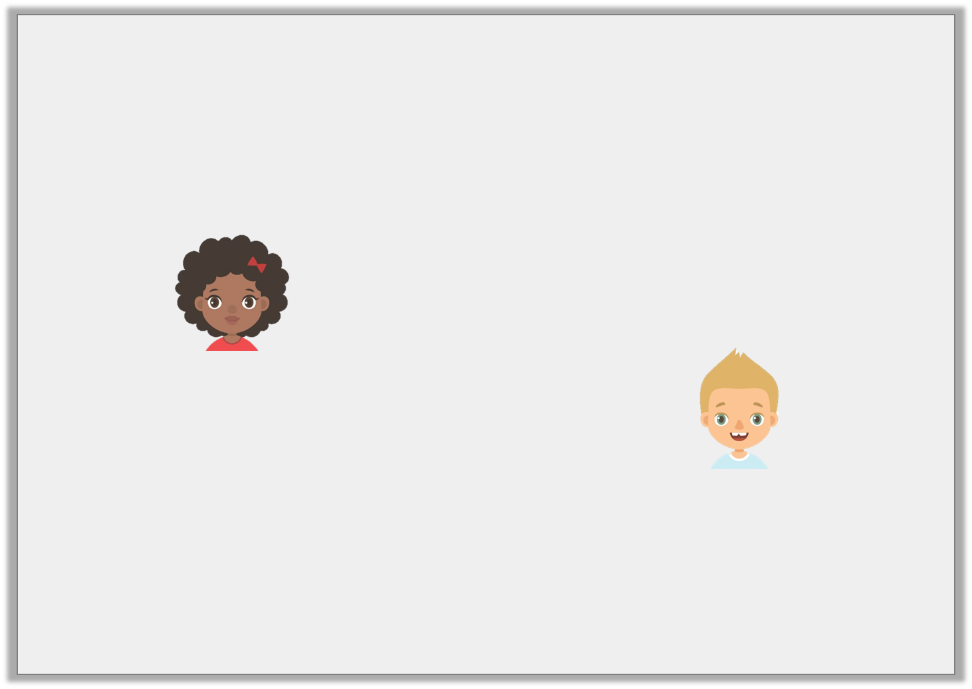
Reasoning 2
Jack and Leah are discussing this image:
Who is correct? Convince me.
It is three wholes and two thirds.
Leah
It is eleven thirds.
Jack
© Classroom Secrets Limited 2019

Slide 16
Reasoning 2
Jack and Leah are discussing this image:
Who is correct? Convince me.
Jack and Leah are both correct because…
It is three wholes and two thirds.
Leah
It is eleven thirds.
Jack
© Classroom Secrets Limited 2019

Slide 17
Reasoning 2
Jack and Leah are discussing this image:
Who is correct? Convince me.
Jack and Leah are both correct because eleven thirds is equivalent to three wholes and two thirds which is shown in the image.
It is three wholes and two thirds.
Leah
It is eleven thirds.
Jack
© Classroom Secrets Limited 2019

