Slide 1
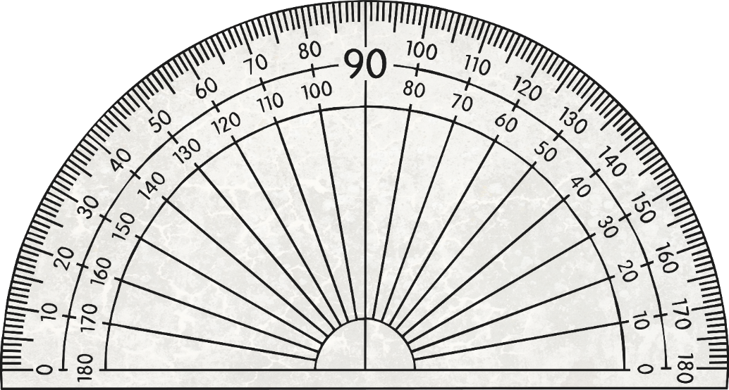
Types of Angles
Angles are measured in degrees, using a special instrument called a protractor.
This protractor measures angles up to 180⁰.

Slide 2
What types of angles do you already know?

Slide 3
What types of angles do you already know?
There are 5 we will learn about today.

Slide 4
Here’s a few hints to help you.
1. R ____ Angle
2. _cute Angle
3. Ob____ Angle
4. St______ Line Angle
5. R_flex Angle

Slide 5
1. Right Angle
2. Acute Angle
3. Obtuse Angle
4. Straight Line Angle
5. Reflex Angle

Slide 6
Right Angle
A right angle is 90⁰.

Slide 7
Right Angle
The right angle (90⁰) is most often symbolised as a square.

Slide 8
Right Angle
This is also a right angle (90⁰).

Slide 9

Right Angle
A right angle is 90⁰.

Slide 10
Acute Angle
An acute angle is less than 90⁰.

Slide 11
Acute Angle
A good way to remember it is ‘cute’ like a small animal.

Slide 12
Acute Angle
An acute angle is less than 90⁰.
Can you calculate how many degrees this angle is?

Slide 13
Acute Angle
An acute angle is 90⁰.
40⁰
Have you noticed the symbol after the number? 40⁰

Slide 14
Obtuse Angle
An obtuse angle is more than 90⁰ but less than 180⁰.
Can you estimate the size of this angle.
Remember, it must be more than 90⁰ but less than 180⁰ .

Slide 15
Obtuse Angle
Do you think it is nearer to 90⁰ or 180⁰?

Slide 16
Obtuse Angle
It was a little closer to 90⁰ than 180⁰.
130⁰

Slide 17
Straight Angle
A straight angle is exactly 180⁰.

Slide 18
Straight Angle
So how many degrees do you think these is on a straight line?
From here
To here

Slide 19
Straight Angle
A straight angle is exactly 180⁰.
180⁰
0⁰

Slide 20
Reflex Angle
A reflex angle is greater than 180⁰ but less than 360⁰.
Will we be able to measure this angle using the protractor we have used previously?

Slide 21
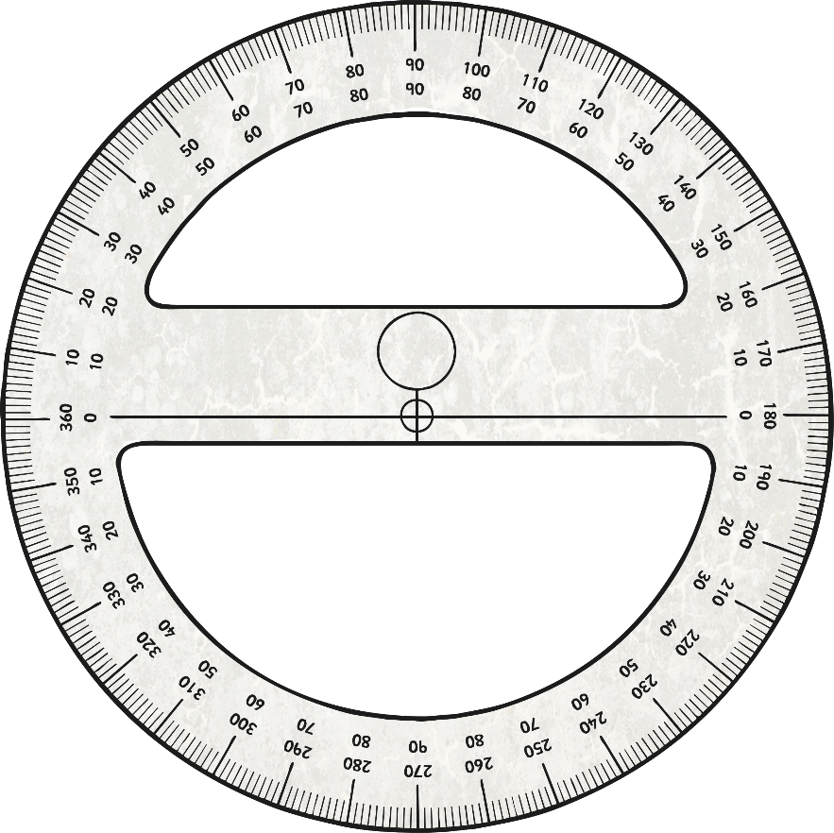
Reflex Angle
A protractor with 360⁰ on it needs to be used as the angles are greater than 180 ⁰.
This is the angle being measured.
220⁰

Slide 22
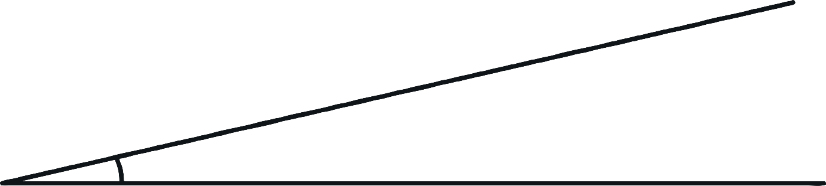
What kind of angle is this?
Right
Acute
Obtuse
Straight
Reflex

Slide 23
What kind of angle is this?
Acute

Slide 24

What kind of angle is this?
Right
Acute
Obtuse
Straight
Reflex

Slide 25
What kind of angle is this?
Right

Slide 26
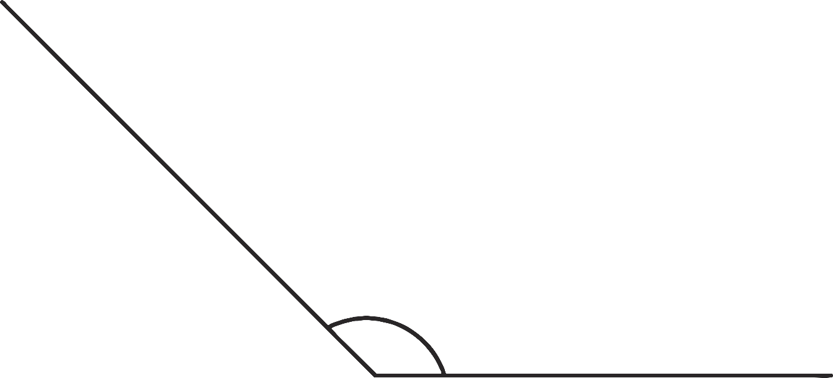
What kind of angle is this?
Right
Acute
Obtuse
Straight
Reflex

Slide 27
What kind of angle is this?
Obtuse

Slide 28
What kind of angle is this?
Right
Acute
Obtuse
Straight
Reflex

Slide 29
What kind of angle is this?
Straight

Slide 30
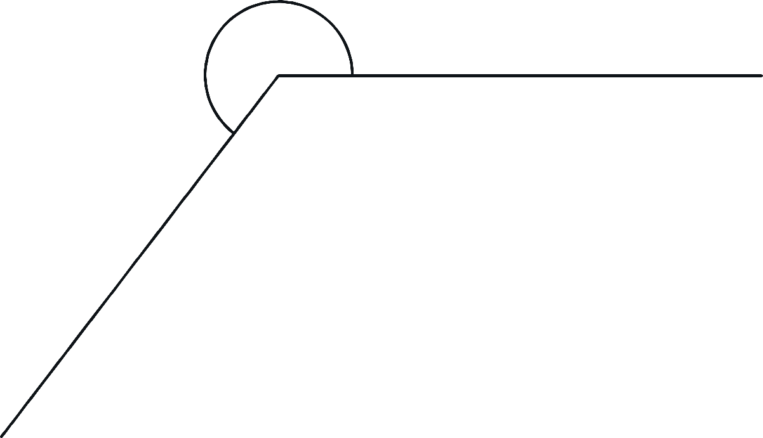
What kind of angle is this?
Right
Acute
Obtuse
Straight
Reflex

Slide 31
What kind of angle is this?
Reflex

Slide 32
