Slide 1
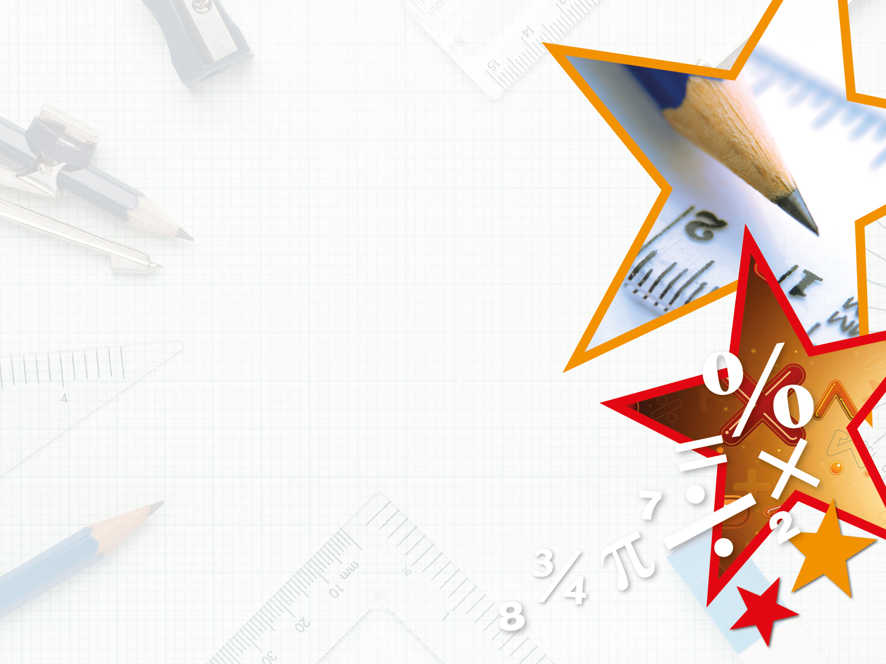

Year 4 – Spring Block 4 – Decimals
Step 2: Tenths as Decimals
© Classroom Secrets Limited 2019

Slide 2
Introduction
Use the part-whole model to partition 38 hundredths
into tenths and hundredths.
38
100
10
100
© Classroom Secrets Limited 2019

Slide 3
Introduction
Use the part-whole model to partition 38 hundredths
into tenths and hundredths.
38
100
3
10
8
100
© Classroom Secrets Limited 2019

Slide 4
Varied Fluency 1
Use the image to complete the fraction and decimal.
 | .
© Classroom Secrets Limited 2019

Slide 5
Varied Fluency 1
Use the image to complete the fraction and decimal.
6
10
0 | . | 6
© Classroom Secrets Limited 2019

Slide 6
Varied Fluency 2
Complete the statement using a decimal.
___ is the same as three tenths.
© Classroom Secrets Limited 2019

Slide 7
Varied Fluency 2
Complete the statement using a decimal.
___ is the same as three tenths.
0.3
© Classroom Secrets Limited 2019

Slide 8
Varied Fluency 3
Draw an arrow to show where 0.1 would be placed on the number line.
Write the decimal as a fraction:
0 |  |  |  |  |  |  |  |  |  | 1
© Classroom Secrets Limited 2019

Slide 9
Varied Fluency 3
Draw an arrow to show where 0.1 would be placed on the number line.
Write the decimal as a fraction:
0 |  |  |  |  |  |  |  |  |  | 1
1
10
© Classroom Secrets Limited 2019

Slide 10
Varied Fluency 4
Circle the odd one out.
0.1
0.1
0.1
0.1
A.
1.
0.2
0.1
0.1
0.1
one tenth
0.7
B.
2.
7
10
0.1
C.
3.
© Classroom Secrets Limited 2019

Slide 11
Varied Fluency 4
Circle the odd one out.
0.1
0.1
0.1
0.1
A.
1.
0.2
0.1
0.1
0.1
one tenth
0.7
B.
2.
7
10
0.1
C.
3.
© Classroom Secrets Limited 2019

Slide 12
Reasoning 1
Hamza is using a number line to represent a decimal.
He writes down the decimal as 0.7.
Is Hamza correct? Explain your answer.
0 |  |  |  |  | 0.5 |  |  |  |  | 1
© Classroom Secrets Limited 2019

Slide 13
Reasoning 1
Hamza is using a number line to represent a decimal.
He writes down the decimal as 0.7.
Is Hamza correct? Explain your answer.
Hamza is incorrect because…
0 |  |  |  |  | 0.5 |  |  |  |  | 1
© Classroom Secrets Limited 2019

Slide 14
Reasoning 1
Hamza is using a number line to represent a decimal.
He writes down the decimal as 0.7.
Is Hamza correct? Explain your answer.
Hamza is incorrect because the arrow on the number line is showing 6 tenths or 0.6.
0 |  |  |  |  | 0.5 |  |  |  |  | 1
© Classroom Secrets Limited 2019

Slide 15

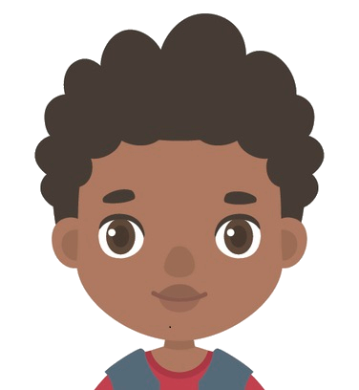
Reasoning 2
Katrina and Joseph are discussing tenths.
Who is correct? Explain your answer.
Five tenths = 50
Katrina
Five tenths = 0.5
Joseph
© Classroom Secrets Limited 2019

Slide 16
Reasoning 2
Katrina and Joseph are discussing tenths.
Who is correct? Explain your answer.
Joseph is correct because…
Five tenths = 50
Katrina
Five tenths = 0.5
Joseph
© Classroom Secrets Limited 2019

Slide 17
Reasoning 2
Katrina and Joseph are discussing tenths.
Who is correct? Explain your answer.
Joseph is correct because five tenths is written as 0.5. Katrina has calculated five tens, not tenths.
Five tenths = 50
Katrina
Five tenths = 0.5
Joseph
© Classroom Secrets Limited 2019

Slide 18
Problem Solving 1
Catherine is thinking of a decimal.
Write down 2 possibilities that Catherine’s decimal could be.
It is smaller than .
7
10
The tenth is an odd number.
0 |  |  |  |  |  |  |  |  |  | 1
© Classroom Secrets Limited 2019

Slide 19
Problem Solving 1
Catherine is thinking of a decimal.
Write down 2 possibilities that Catherine’s decimal could be.
Various answers, for example: 0.1 and 0.3
It is smaller than .
7
10
The tenth is an odd number.
0 |  |  |  |  |  |  |  |  |  | 1
© Classroom Secrets Limited 2019

